Slide 1
Final Portfolio
Hamna Shahzad
2019190211
Manga and the Illuminated Text
Professor Goodman Loren

Slide 2
Thesis Statement
While going through all my previous works, I must admit that I was really surprised that I was able to make so many artworks related to and inspired by different artists every week. The first weeks in the manga class were admittedly difficult because it had been so much time since I last picked up a single color pencil. In my opinion, some of my first manga assignments where I had to actually draw characters was a really tough. I was not satisfied with my drawing (the mysterious skeleton and the spirit and the guard), and I was even embarrassed at the idea of a workshop analyzing my shoddy work.

Slide 3
However, after two or three of those assignments and after seeing some of the artwork in the workshops ,I realized that I was working in the wrong direction all along. Instead, of working on the aesthetics, I needed to work on the creative inspiration and making a simple drawing instead of complicating it with a lot of backgrounds and characters (a tip I learned from one of the guest speakers). Most of this work in my portfolio is either done with the help of color pencils and calligraphy brush pens or through procreate where I usually relied on my brush marker and studio pens.

Slide 4
For my portfolio, I have as you can see decided on a dark blue and peach with a faded white theme. The reason for this is the fact that I believe that some of the drawings would look good with a warm tone and others would suit well with cool tones. The warm tone ones usually tend to have a simpler message whereas the dark blue background ones do tend to be rather more tacit in their meaning. With these points in mind, I would like to present my portfolio and I hope you enjoy its messages as much as I did.

Slide 5
My Works

Slide 6
CHAI
When I was thinking of writing a poem for our assignment on William Blake, i really wanted to write something that i was as passionate about as Blake was when he wrote his poems. The only thing that comes to mind for me is Chai because it is something that i have grown up seeing and something that is drunk at least three times in Pakistani culture.
I remembered seeing this advertisement in a starbucks once where they labelled chai as ‘chai tea’ which is the equivalent of saying ‘tea-tea’ . For some reason, i was really upset because the culture of colonisation has even taken away some of the most traditional food and drinks and appropriated it into their own. This poem is my way of ranting on the appropriation of chai and i have deliberately chosen warm tones such as orange and yellow to highlight both the familiar smell of chai as well as my passion about the topic.

Slide 7
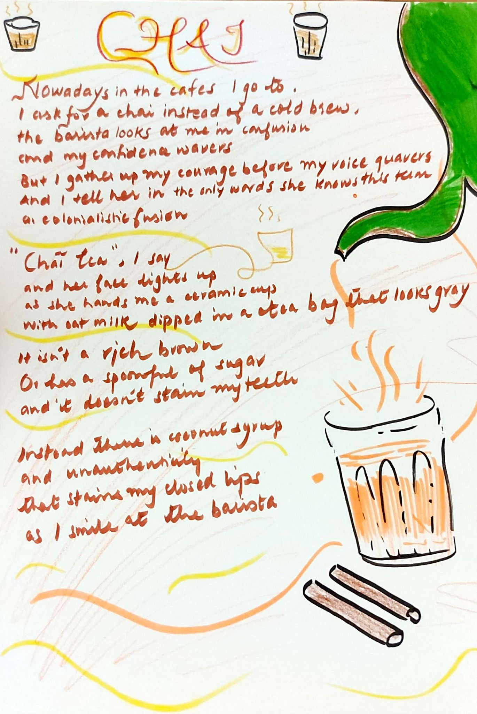

Slide 8
How to make Chai ‘tea’
This recipe is a way of paying ode to my previous poem which also talked about the inauthentic way of making chai . Chai is something that pakistani people take pride in making and the person who is successful in creating the correct way of making a ‘dabba’( places in Pakistan to drink chai from) style chai is considered one of the most important people in families and colleges.
The man i have drawn on the right is a traditional tea maker who specialises in dabba style chai. Their clothes are similar to the ones ive drawn below .
The recipe of this chai is my grandmother’s so i can guarantee its taste,

Slide 9
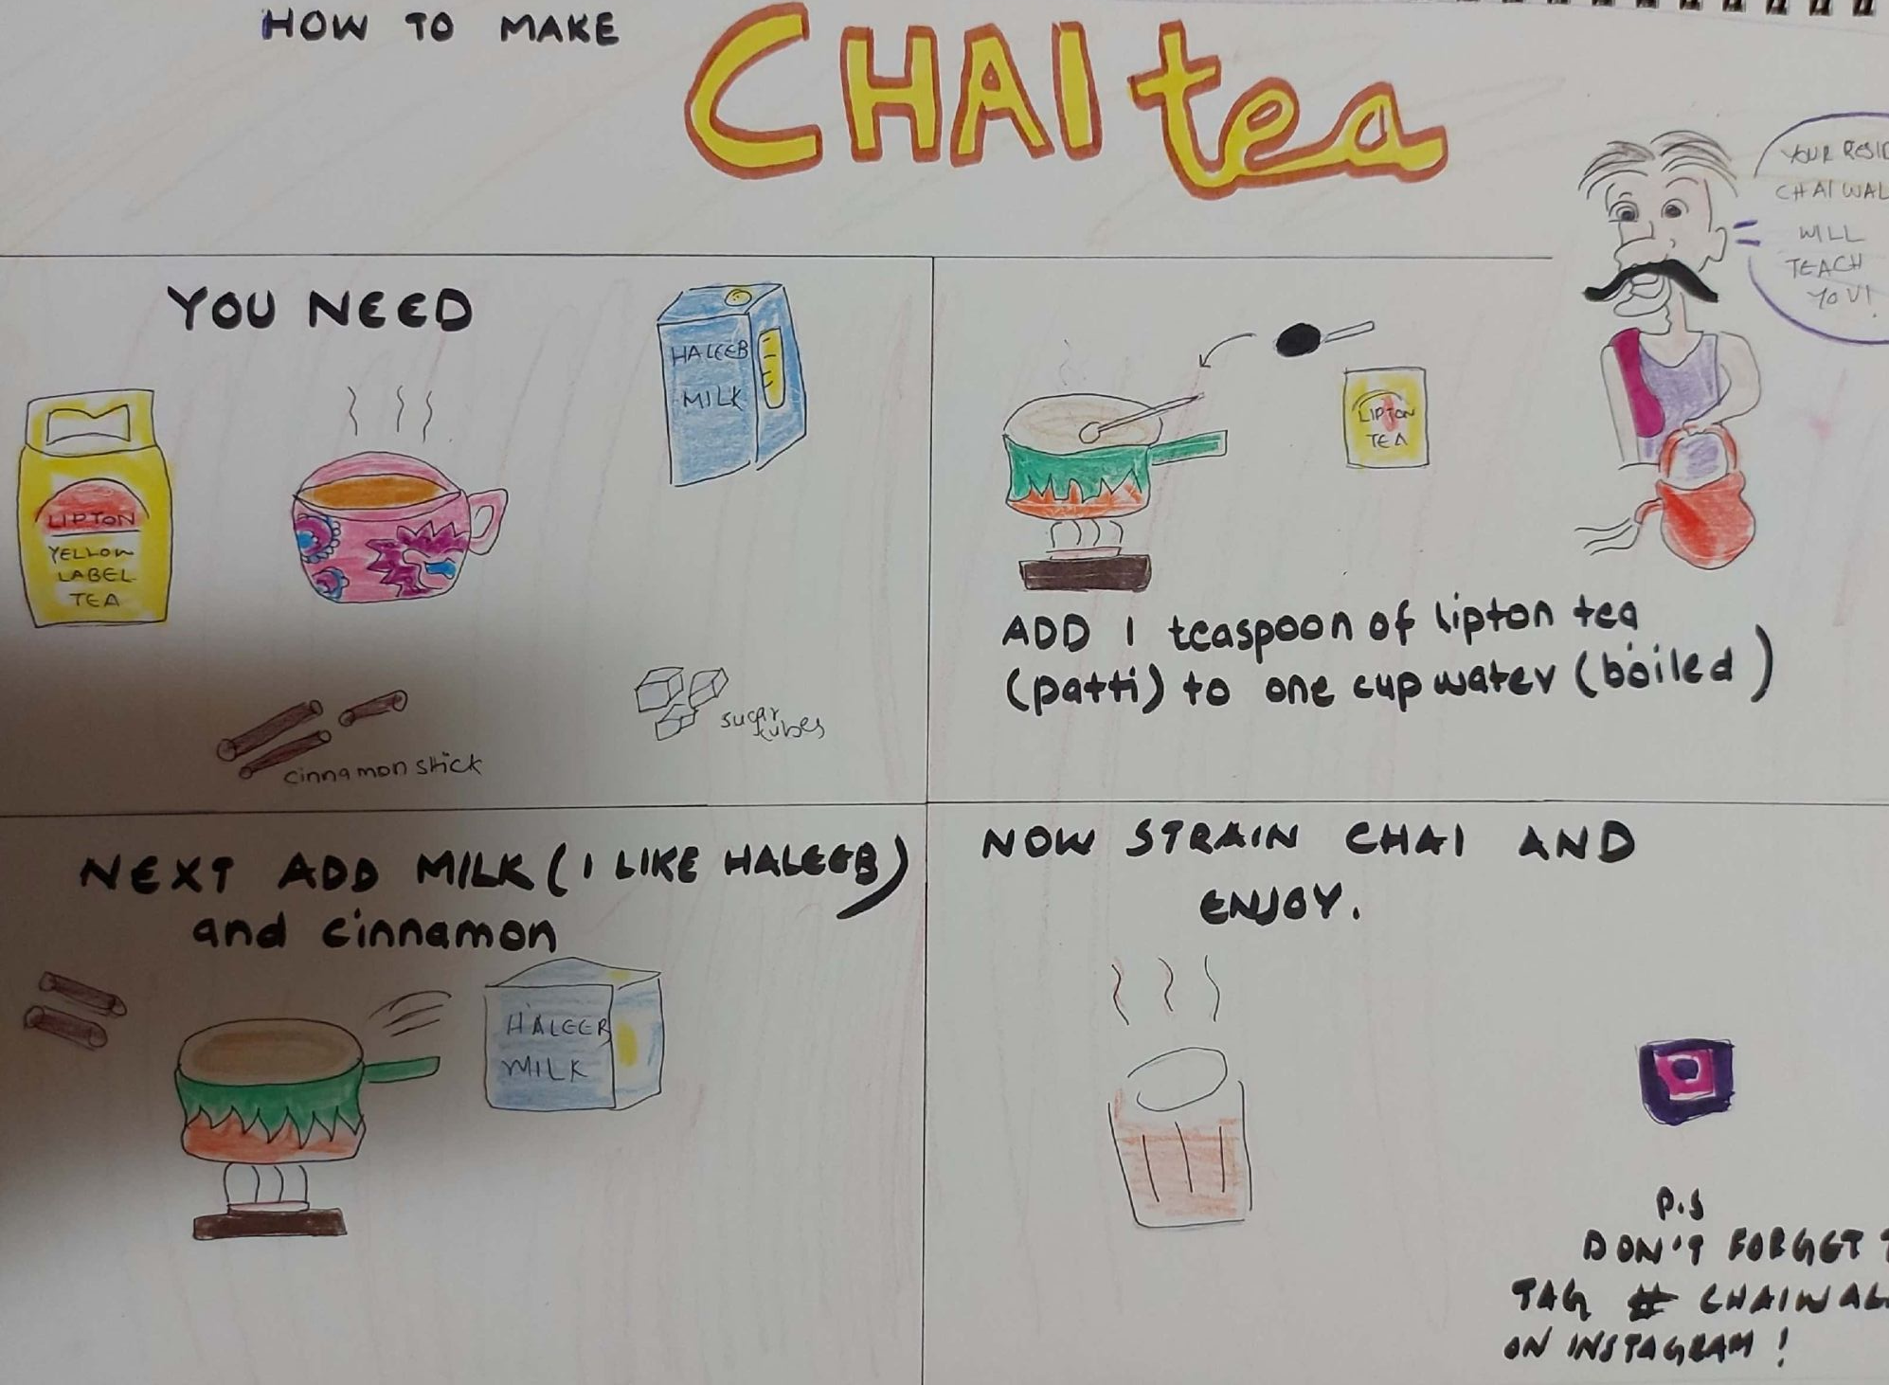

Slide 10
‘CURRY’
This piece is similar in its theme to the previous works on chai. However, in this case i have not made the piece myself but actually taken it from the internet online and then add the red streaks to highlight my message just like Barbara Kruger’s art pieces. This was done mainly to get my point across about the liberal usage of the word ‘curry’.
There has been a very recent debate among people from the subcontinent on how people from other countries just generalise all Pakistani, Indian and Bangladeshi cuisine as ‘curry’. It would be the same as calling meatballs, pasta and tteokbokki as ‘stew’. Brown people do not even use the word curry for their dishes and instead have really different names for every dish which is different in taste and looks. This pieces stresses the fact while showing a picture of my all time favourite dish: sarson ka saag.”

Slide 11
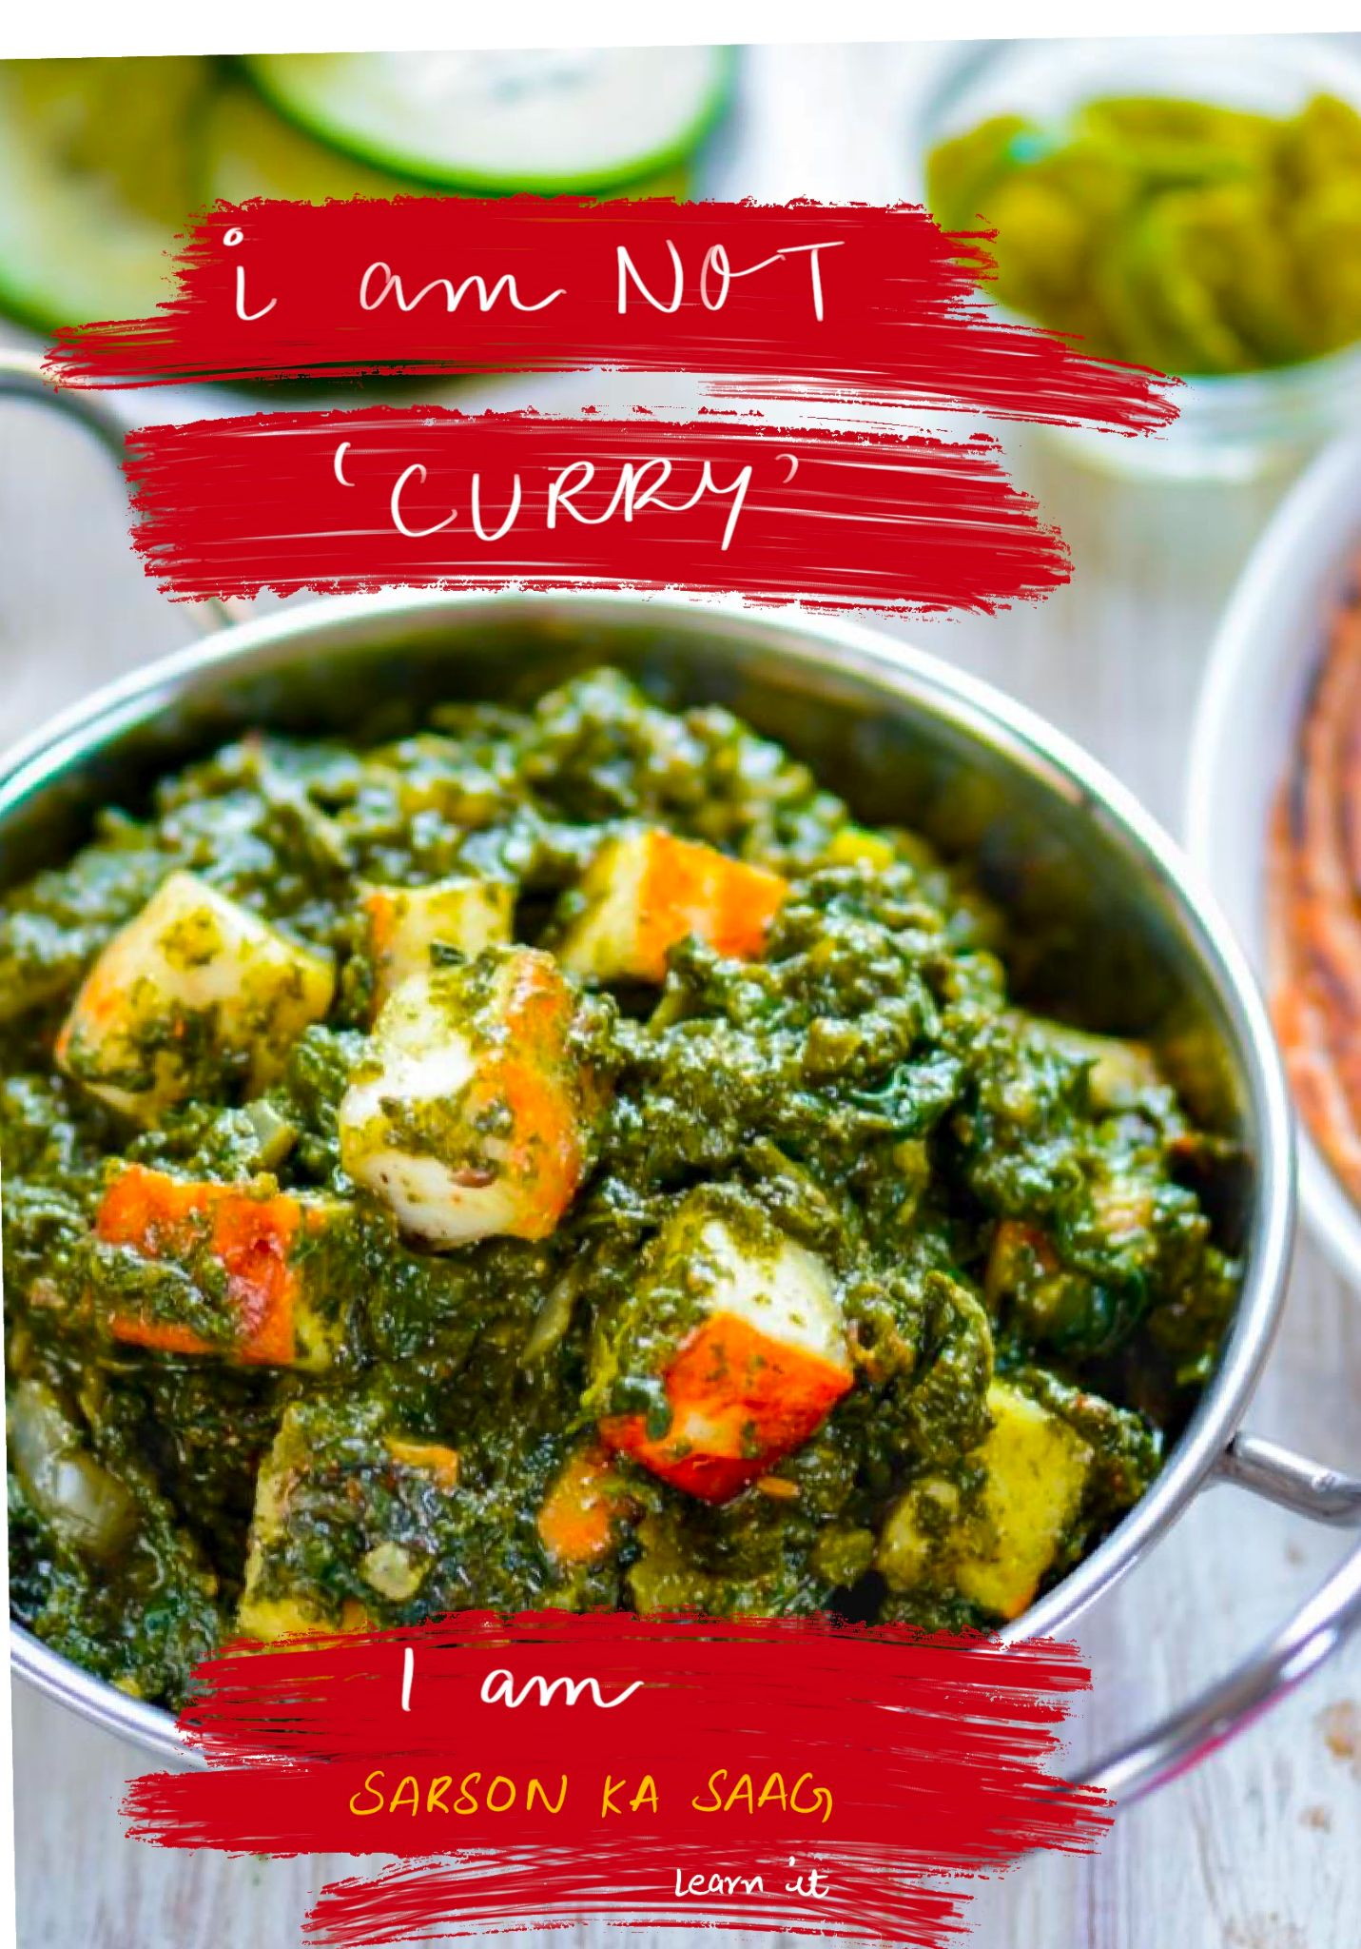

Slide 12
THE SPARROW OF HEAVEN
This piece is very close to my heart because it is based on a story my mother has told me. My name is Hamna which is written as in Urdu and Arabic . It means the sparrow of heaven or paradise and supposedly their personality was supposed to be a good sign. I used the urdu letter to make the sparrow while adding these three water colors in light pink, light green and light purple. The green represents Earth or this world while the pink represents ascendence to heaven. The purple color in between is the sparrow which resides between both places and will transform spiritually into the heavens.

Slide 13
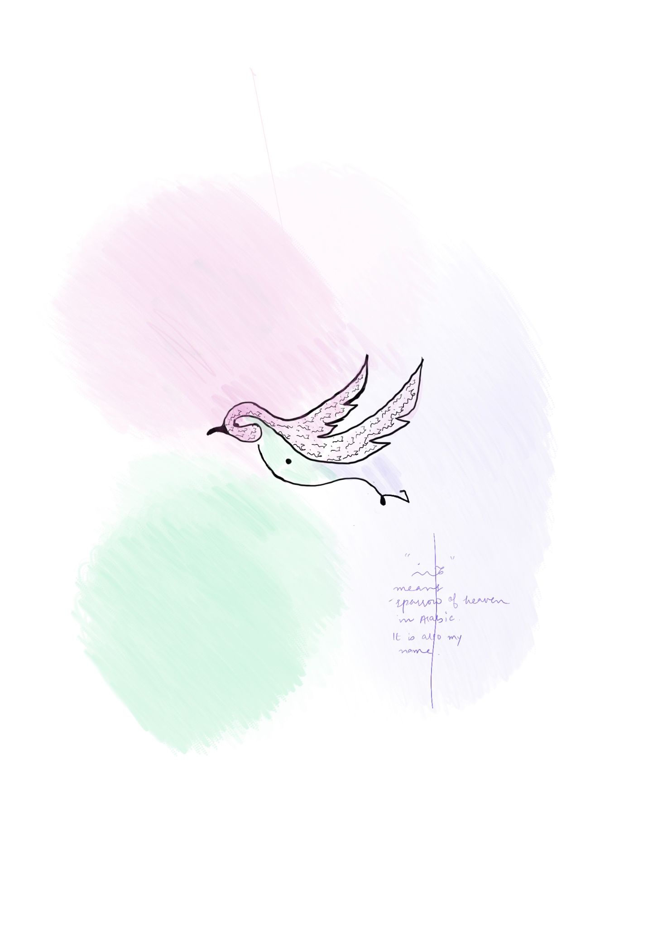

Slide 14
Gumiho
I was greatly inspired by Junko Mizuno’s use of monster type characters that are at once colorful and otherworldly . The only thing that came to mind for me was the korean legend of Gumiho which collects life spirits and is essentially a nine tailed fox. Like the sparrow of heaven piece , i used green, pink and purple to represent her supernatural quality that could ascent between heaven and earth.

Slide 15
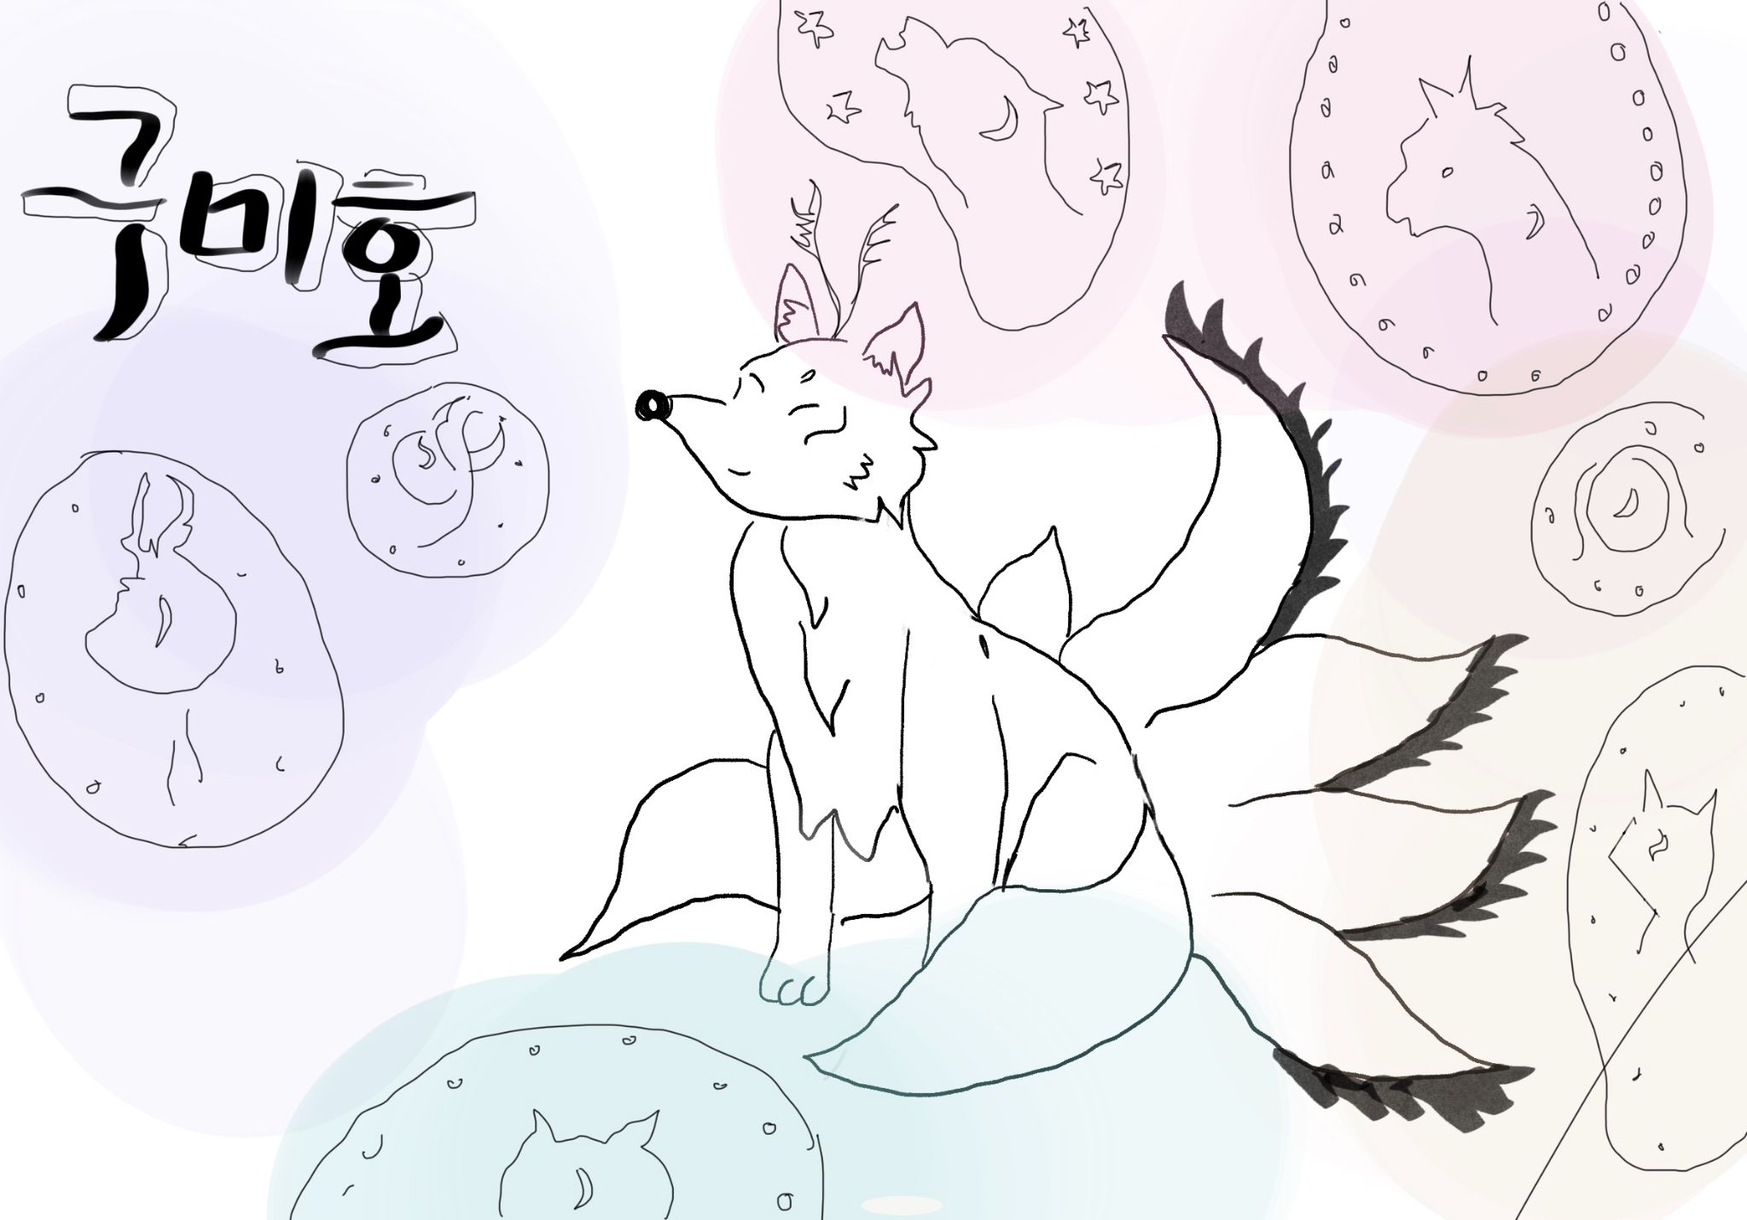

Slide 16
Zoom University
This piece is an nod to my two years as an online student and in many ways Zoom University (which i have purposely stylised to look like Yonsei university’s logo). There is a gradual progression from my original self (the sparrow ) to the owl who does not get sleep and then the seagull who represents abandonment and ironically peace from parties and finally to a depressed little bird. I have purpiosedly used the red color to highlight intense emotions of the birds as well as the rainbow colors for the disco ball.

Slide 17
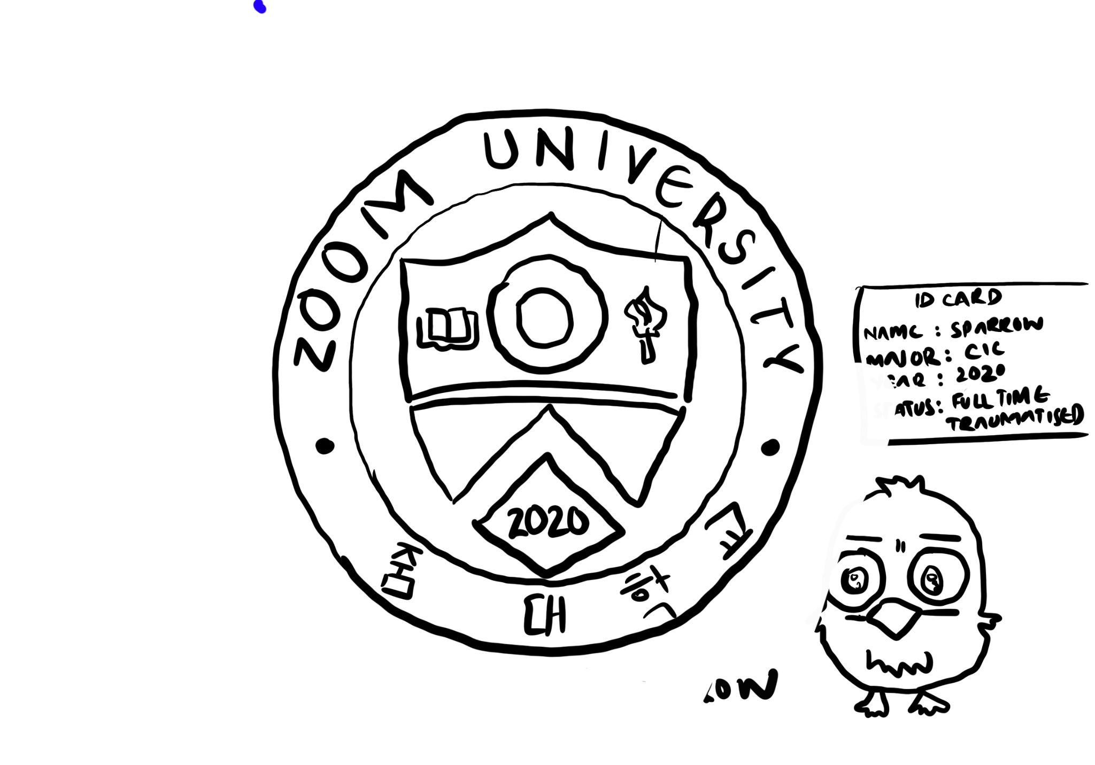

Slide 18
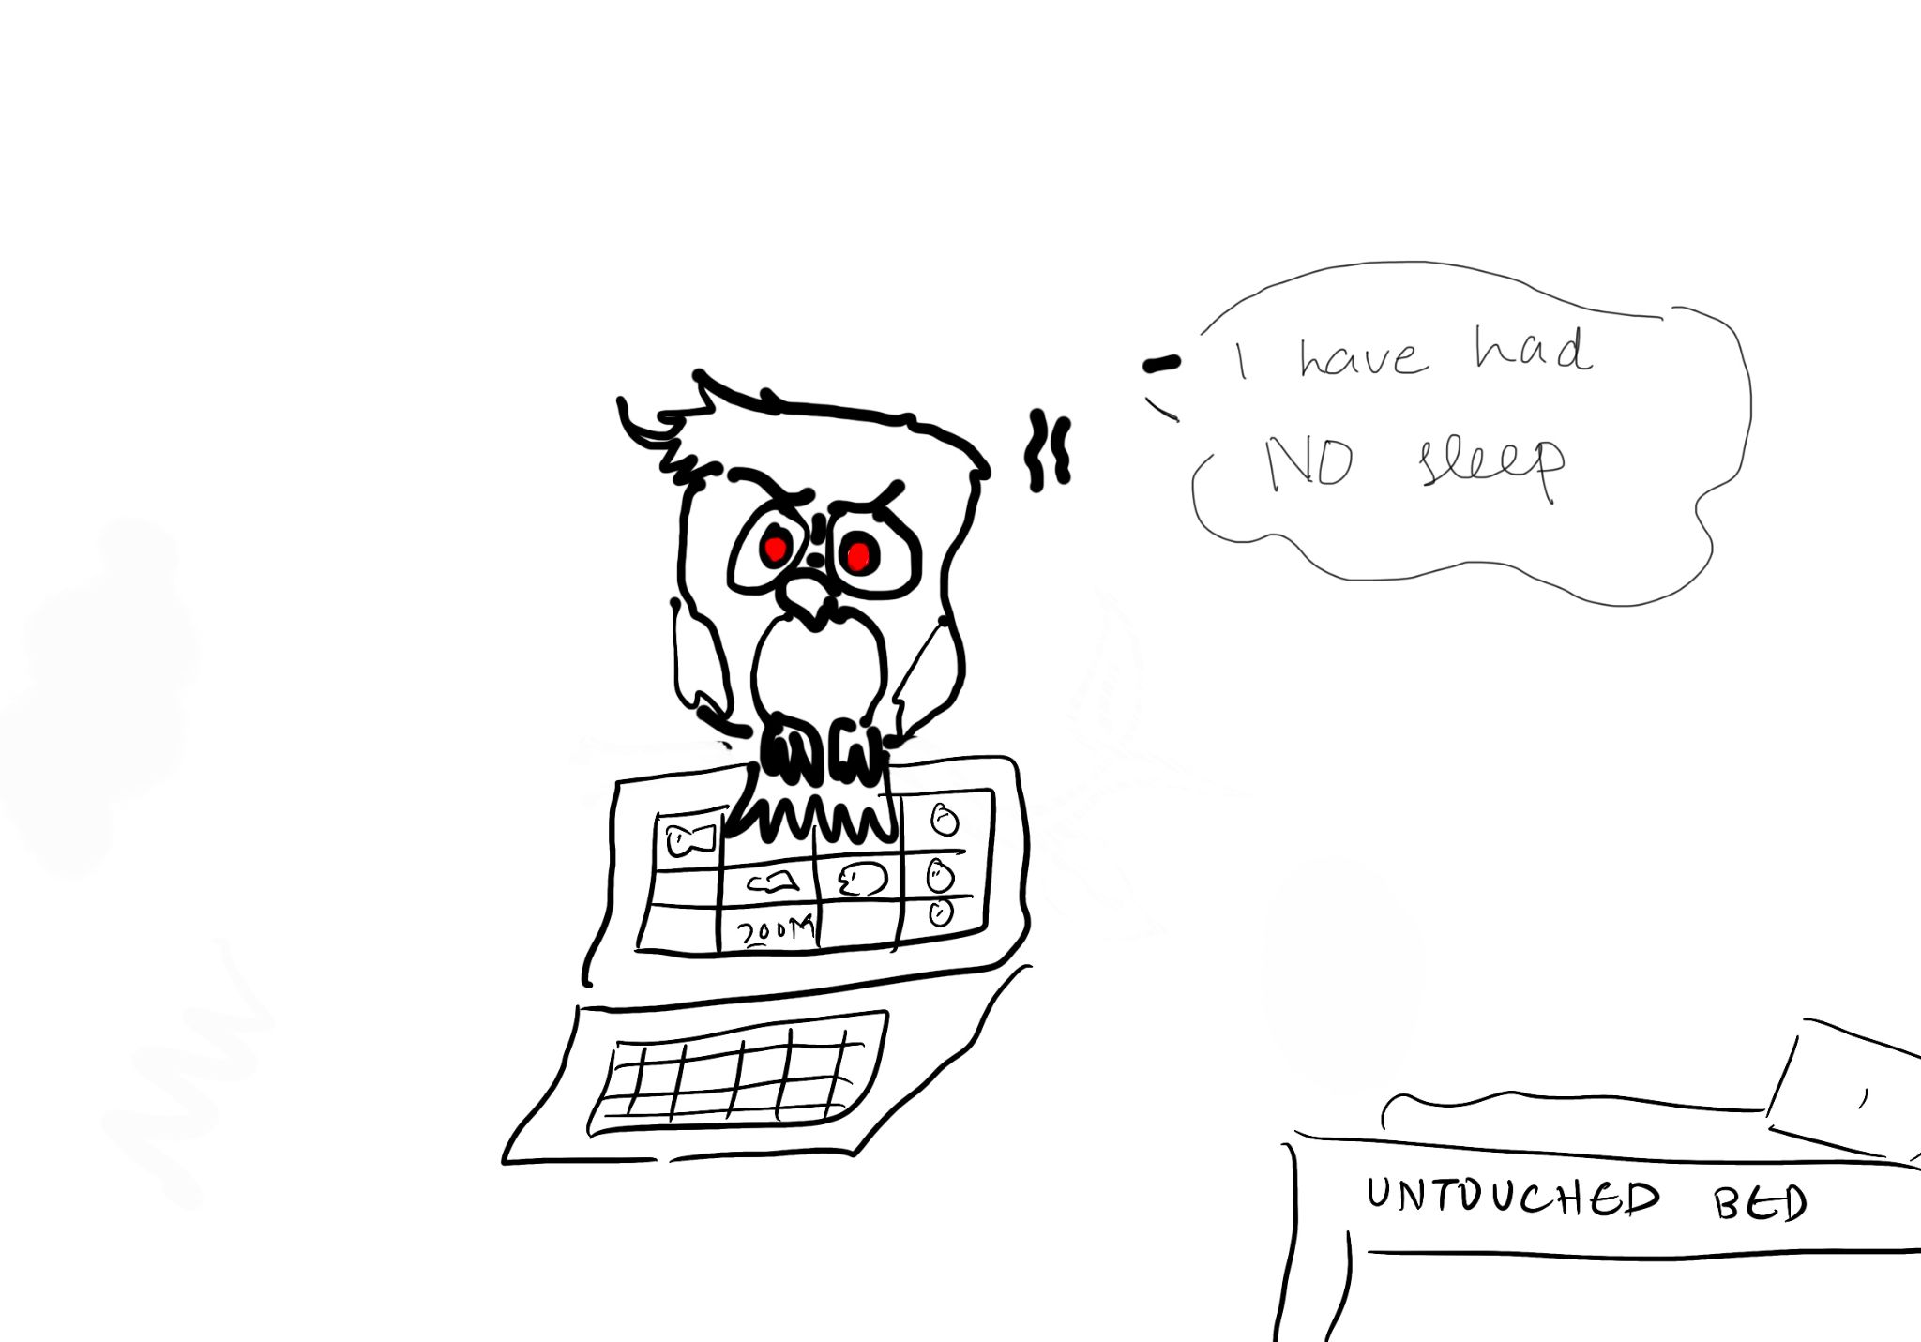

Slide 19
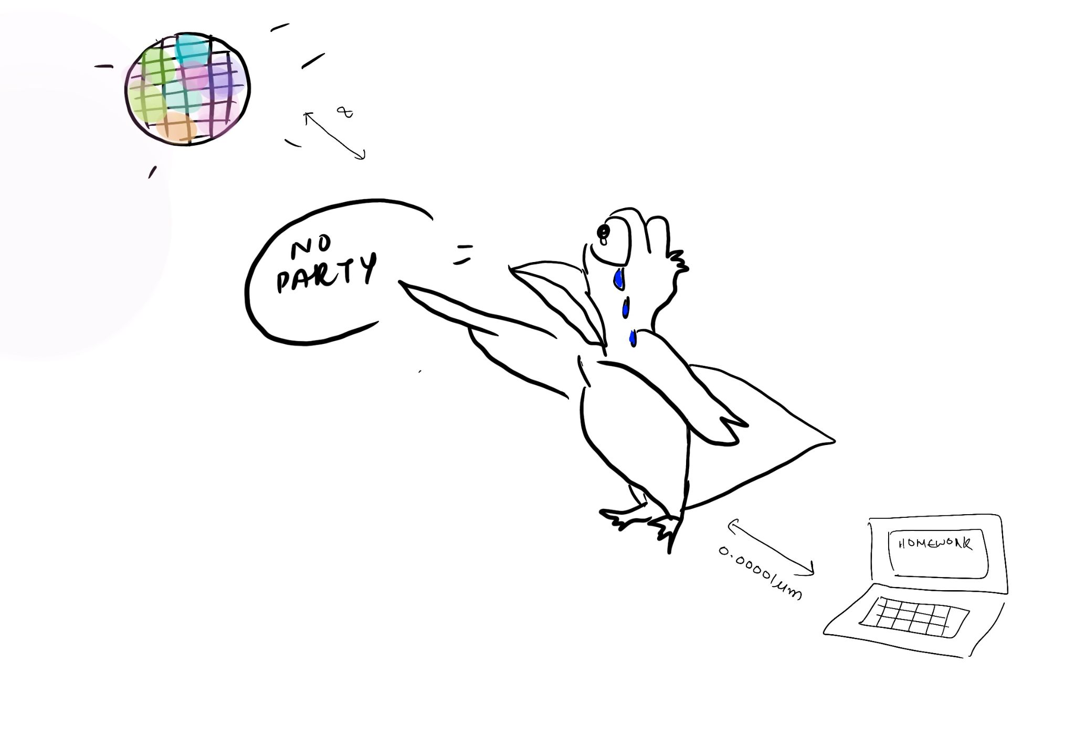

Slide 20
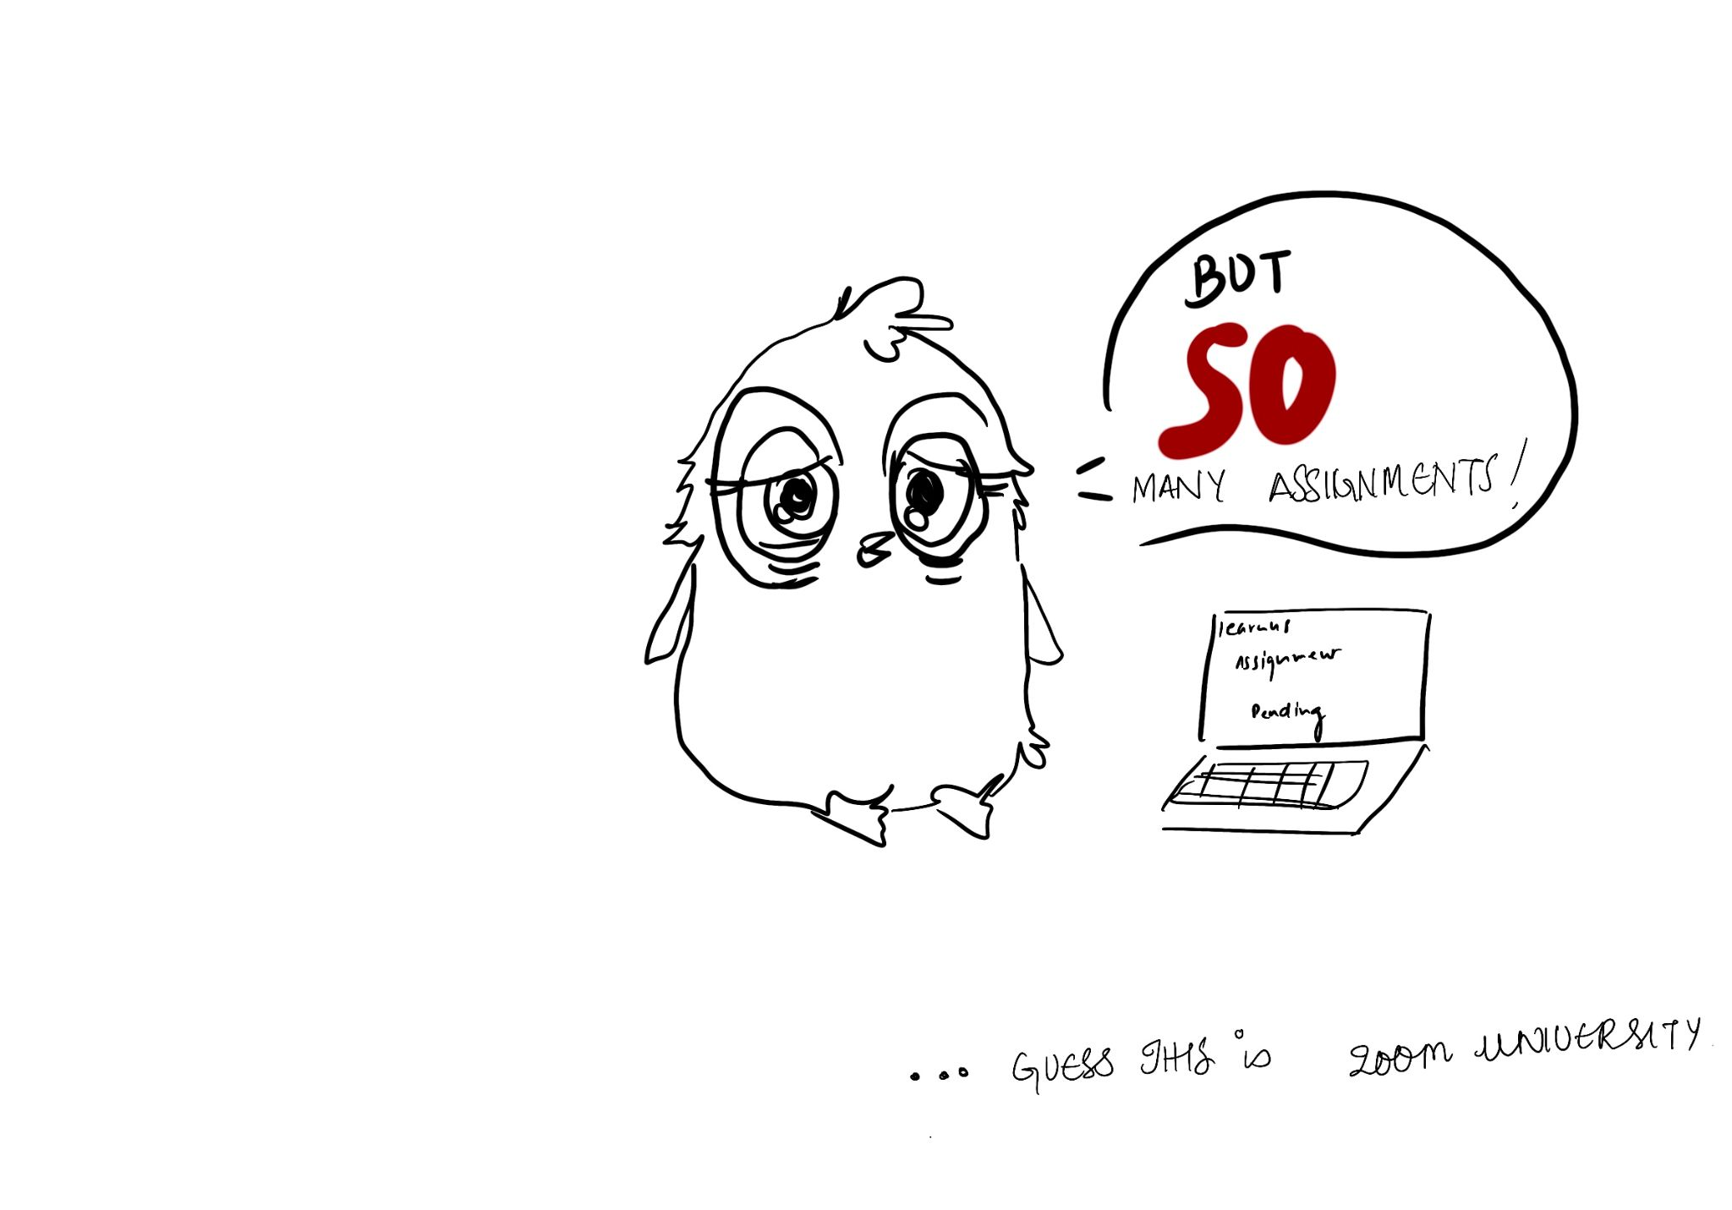

Slide 21
Anxieties of an International Student
This piece is a bit self explanatory in its contents and has a similar theme to Zoom university where it basically talks about the stresses of college life. I want to focus here on the art style because i have chosen to use only a marker brush pen and black with a white background to highlight the seriousness of the situation. In addition,i wanted to use the technique i have seen in a lot of biology textbooks and even mangas where they kind of make a human with an outline and then emphasize their main traits using short phrases and compartments.

Slide 22
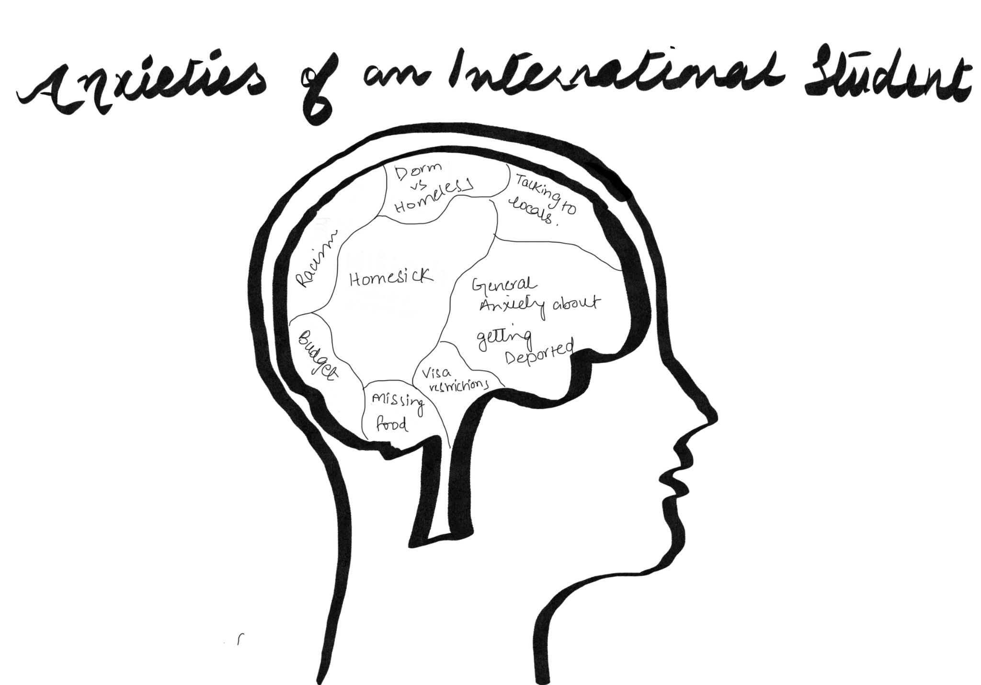

Slide 23
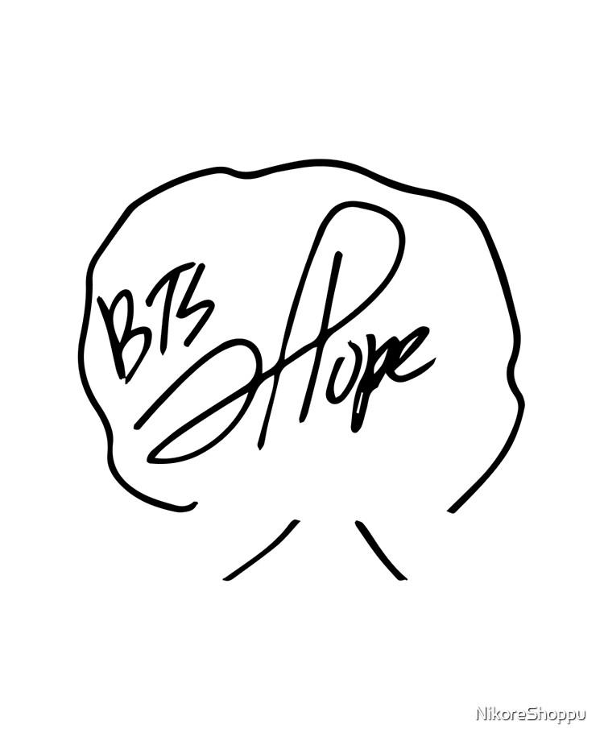
THE PILLAR OF STRENGTH
While making this piece,i had only one thought and that was to signify that my extreme appreciation for teachers. There are so many teachers throughout my life who have been great mentors and i have always been thankful for them being my pillar of strength. In many ways they resemble a tree who give wisdom and shade from the world’s harsh judgments. This simple drawing was actually inspired by BTS J- Hope’s signature(shown on the right) which is a tree and i have always been inspired by the optimistic yet simple design of it so i have decided to emulate it in this doodle.

Slide 24
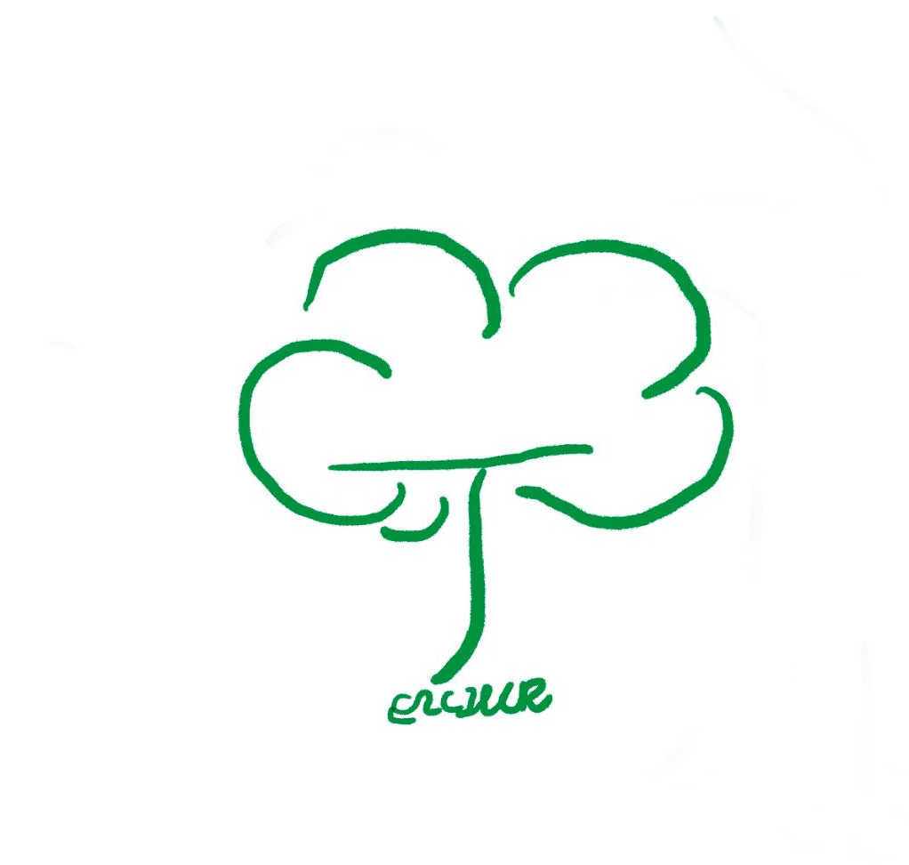

Slide 25
Harold and the Purple Crayon
This is just a rendition of Harold which i had sketched for my presentation.I was immediately struck by how difficult it is to exactly duplicate the drawing even with its seemingly simple lines and circles. I was truly impressed by the clean design and it is among my favourites of most iconic and expressive characters next to Charlie from Peanuts.

Slide 26
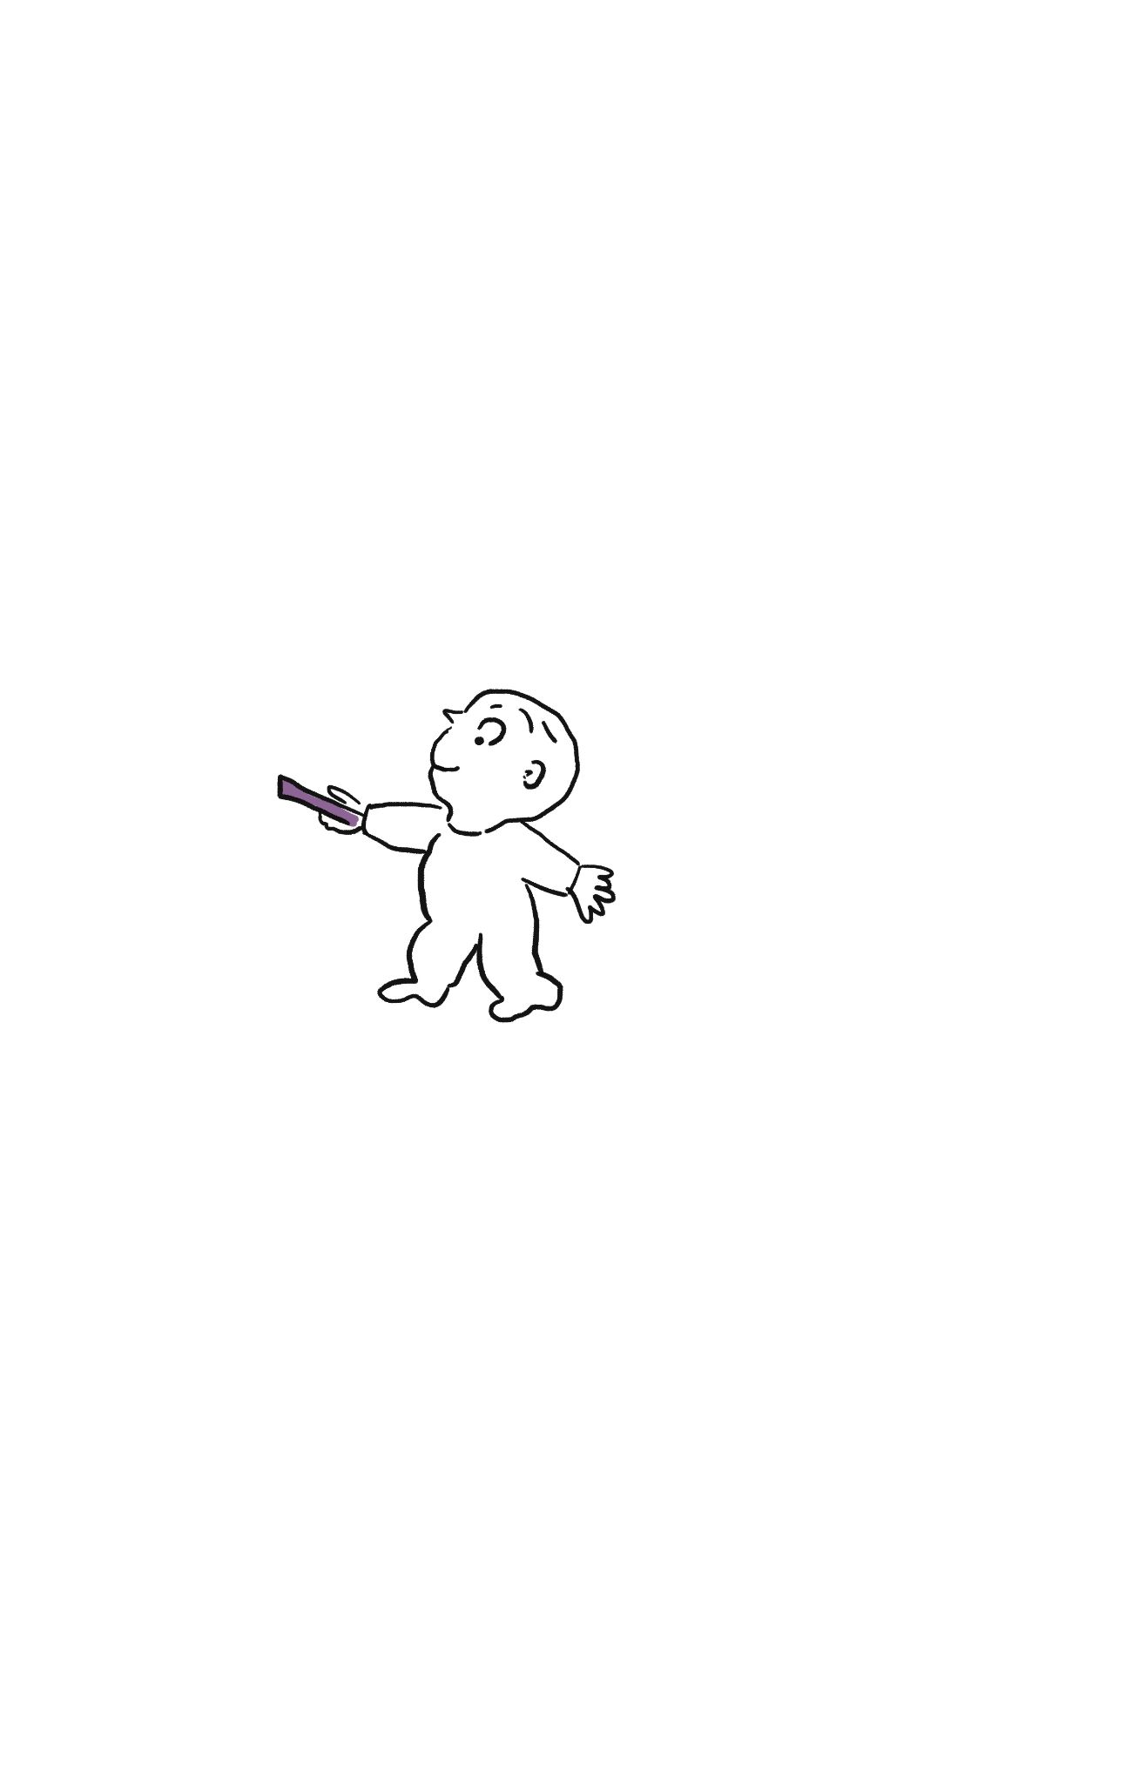

Slide 27
Legged Pals
THIS collaborative work took the longest to complete but it was also one of my memorable parts of the class.We had to draw about seven reworks where we drew a bucket and then redrew over it and tried to correct the lines of the cartoon octopus. We tried to keep it without any dialogues so that the viewers could focus on the changing colors of the octopus and how his emotions change with it.

Slide 28
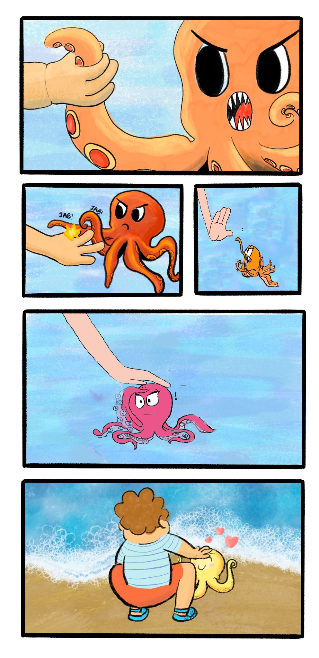

Slide 29
Grandpa Muoh teaches the Fishies
This piece was an exact usage of my fellow classmates original character , Grandpa Muoh. I was really impressed with the initial characterisation of grandpa muoh as someone who is wise and caring- a great reflection of the buddha. I thought it would be very fitting to use him as the spokesperson to preach buddha’s teachings and quotes as an appropriate ode to his birthday. I have also purposely added the purple and seagreen colors to buddha as well as the rather sheepish characters of the fishies to highlight a sort of manga.

Slide 30
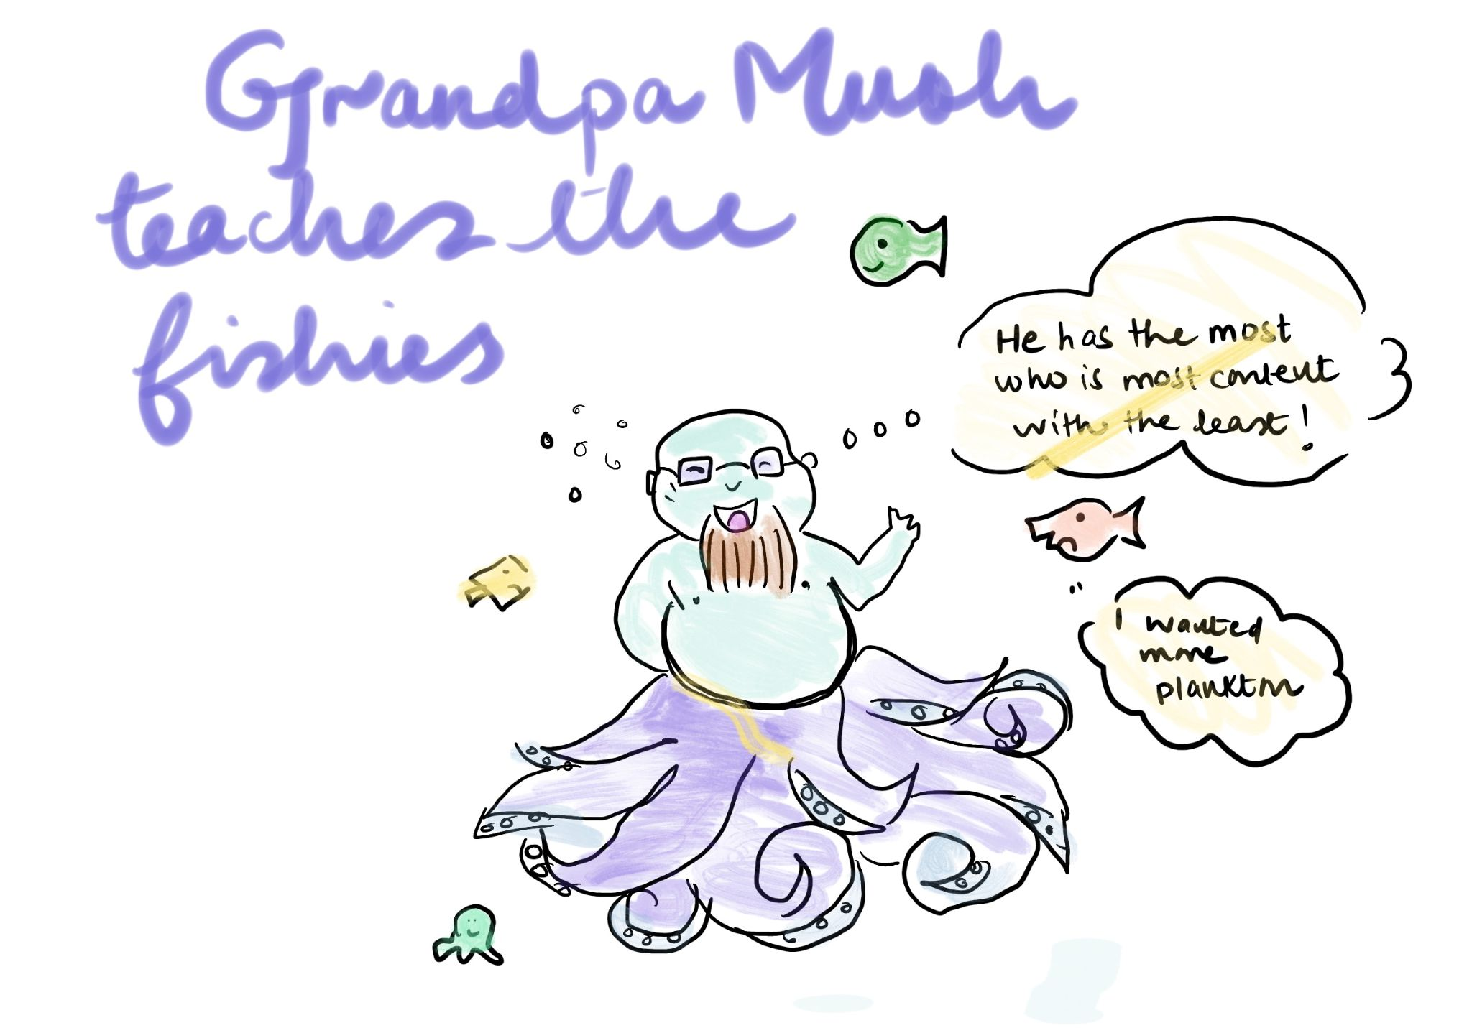

Slide 31
The King’s Order
For this piece, I had to work out a lot of geometrical shapes and borders and took inspiration from the book of kells . The written pisces are actually excerpts i found on the internet of them and i tried to replicate them as faithfully as possible with my calligraphy brushes.I tried to use a lot of yellow and blue colors to make it seems as if the colors were actual gold print.

Slide 32
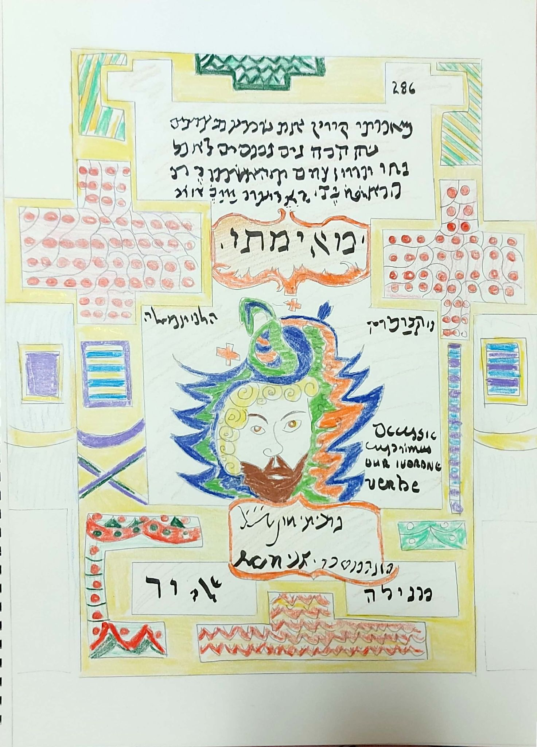

Slide 33
THE Dameli Relic
For this relic , i had actually made up alot of its origins and made the colors similar to that of an elephant and a scroll. The fire is supposed to highlight its significant as a relic of considerable importance and wisdom.

Slide 34
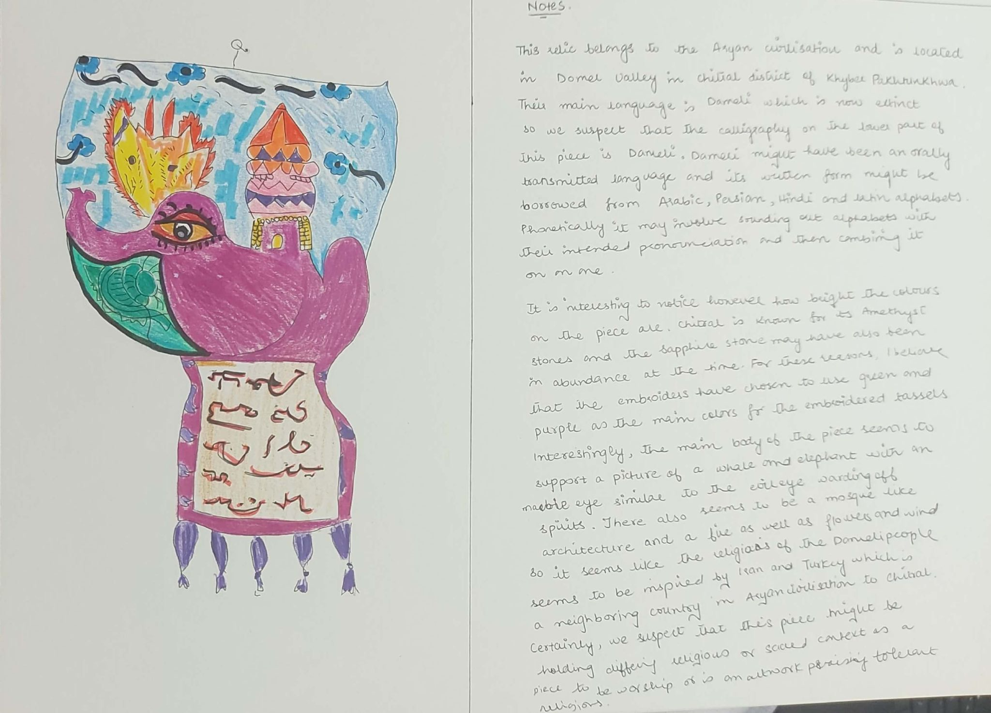

Slide 35
OKRA and the Mayan Glyph Chak Chel
This piece was originally inspired from Chak Chel who is an ancient and powerful goddess of destruction. I found her character to be very similar to that of Medusa(hence the snakes) so i modelled Okra’s character into an anime one after seeing both of them.

Slide 36
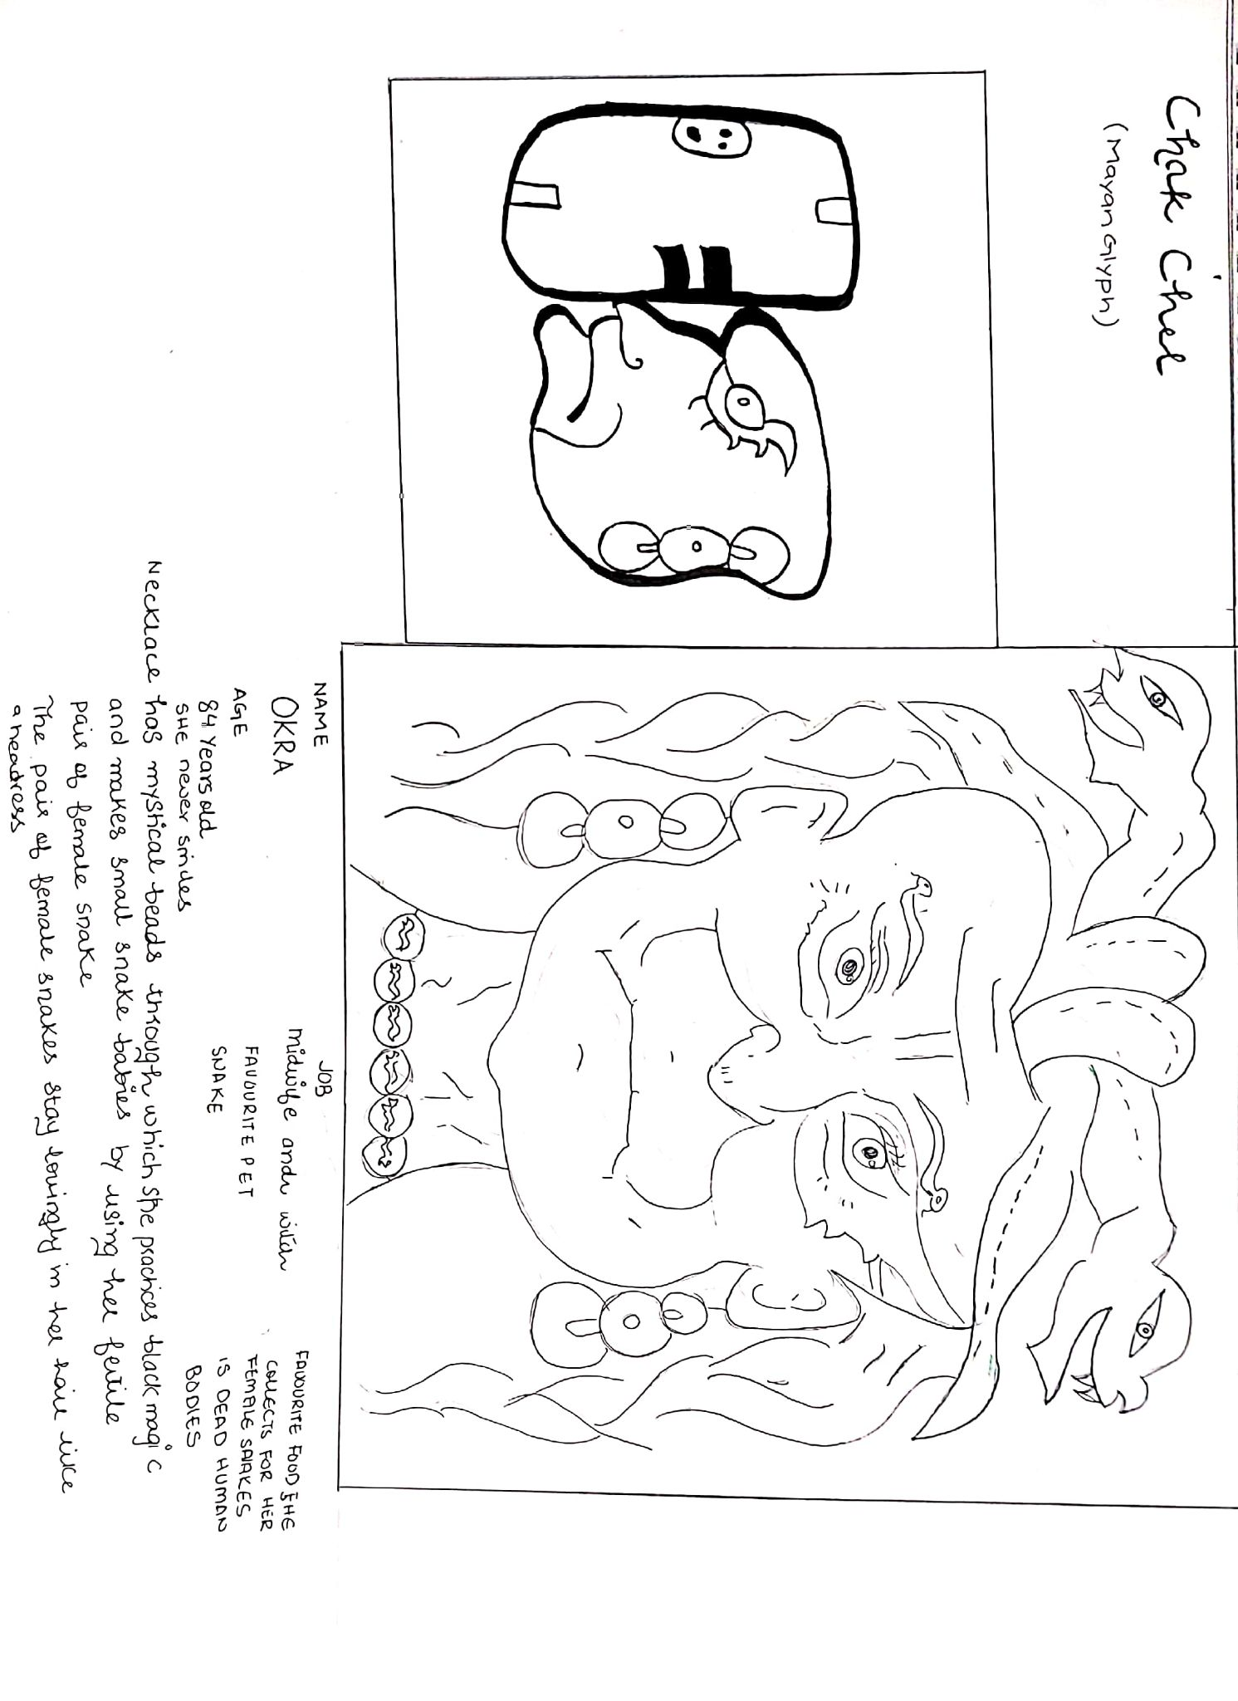

Slide 37
THE 2010’S ROMCOM
This work was actually inspired and is intended to be a crash course on all the stock characters in 2010 american romcom.I always found these characters unrelatable and very cliche but they also contributed to my understanding of this genre and stock characters in general. Due to their cliche nature i decide to make look like they were just sketched and the background of the square boxes that are partially erased are designed to show that there still seems to be some depth that needs to be erased from the characters before they become virtually unrelatable and a thing of only the 2010’s.

Slide 38
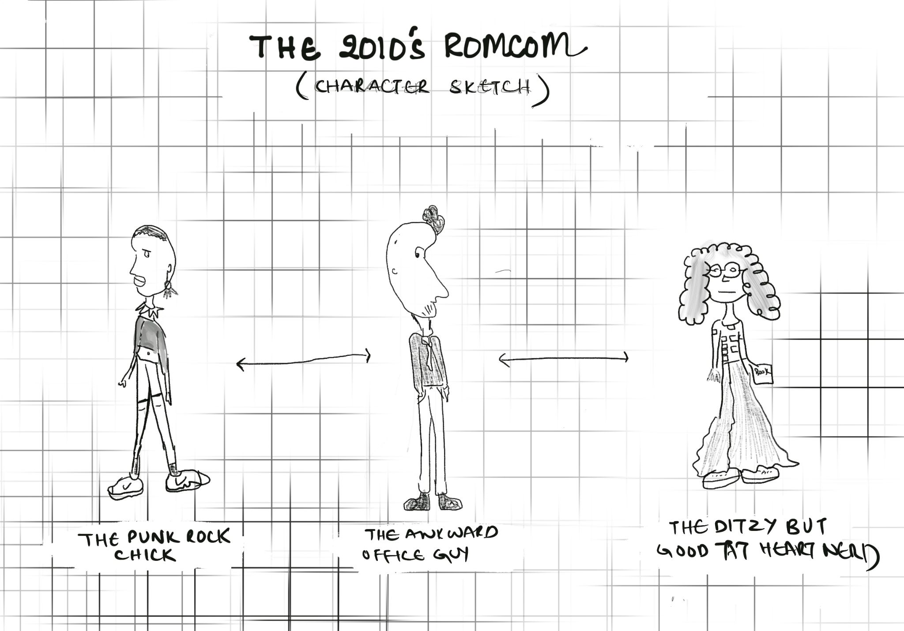

Slide 39
JUGHEAD’S FASHION TRENDS
The color scheme of this piece was intentionally kept to be bright and sparkling so as to give the feeling of a type of a magical if not eccentric fashion show. I tried to do this by purposely using red and yellow.

Slide 40
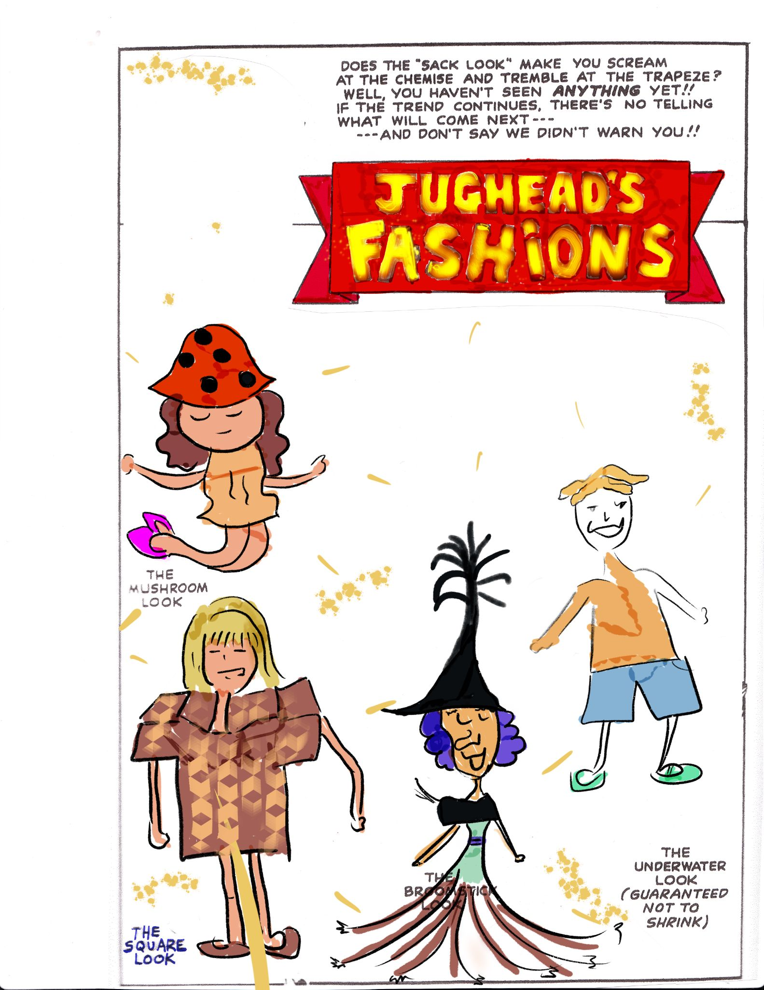

Slide 41
THE FOUNDER OF THE COUNTRY IS THE COUNTRY’S WEAKNESS
This propaganda piece was done especially in mind with my country, Pakistan’s issue of using the founder of our country, Quaid -E-Azam Jinnah to emotionally blackmail and fool its citizens into doing their bidding.

Slide 42
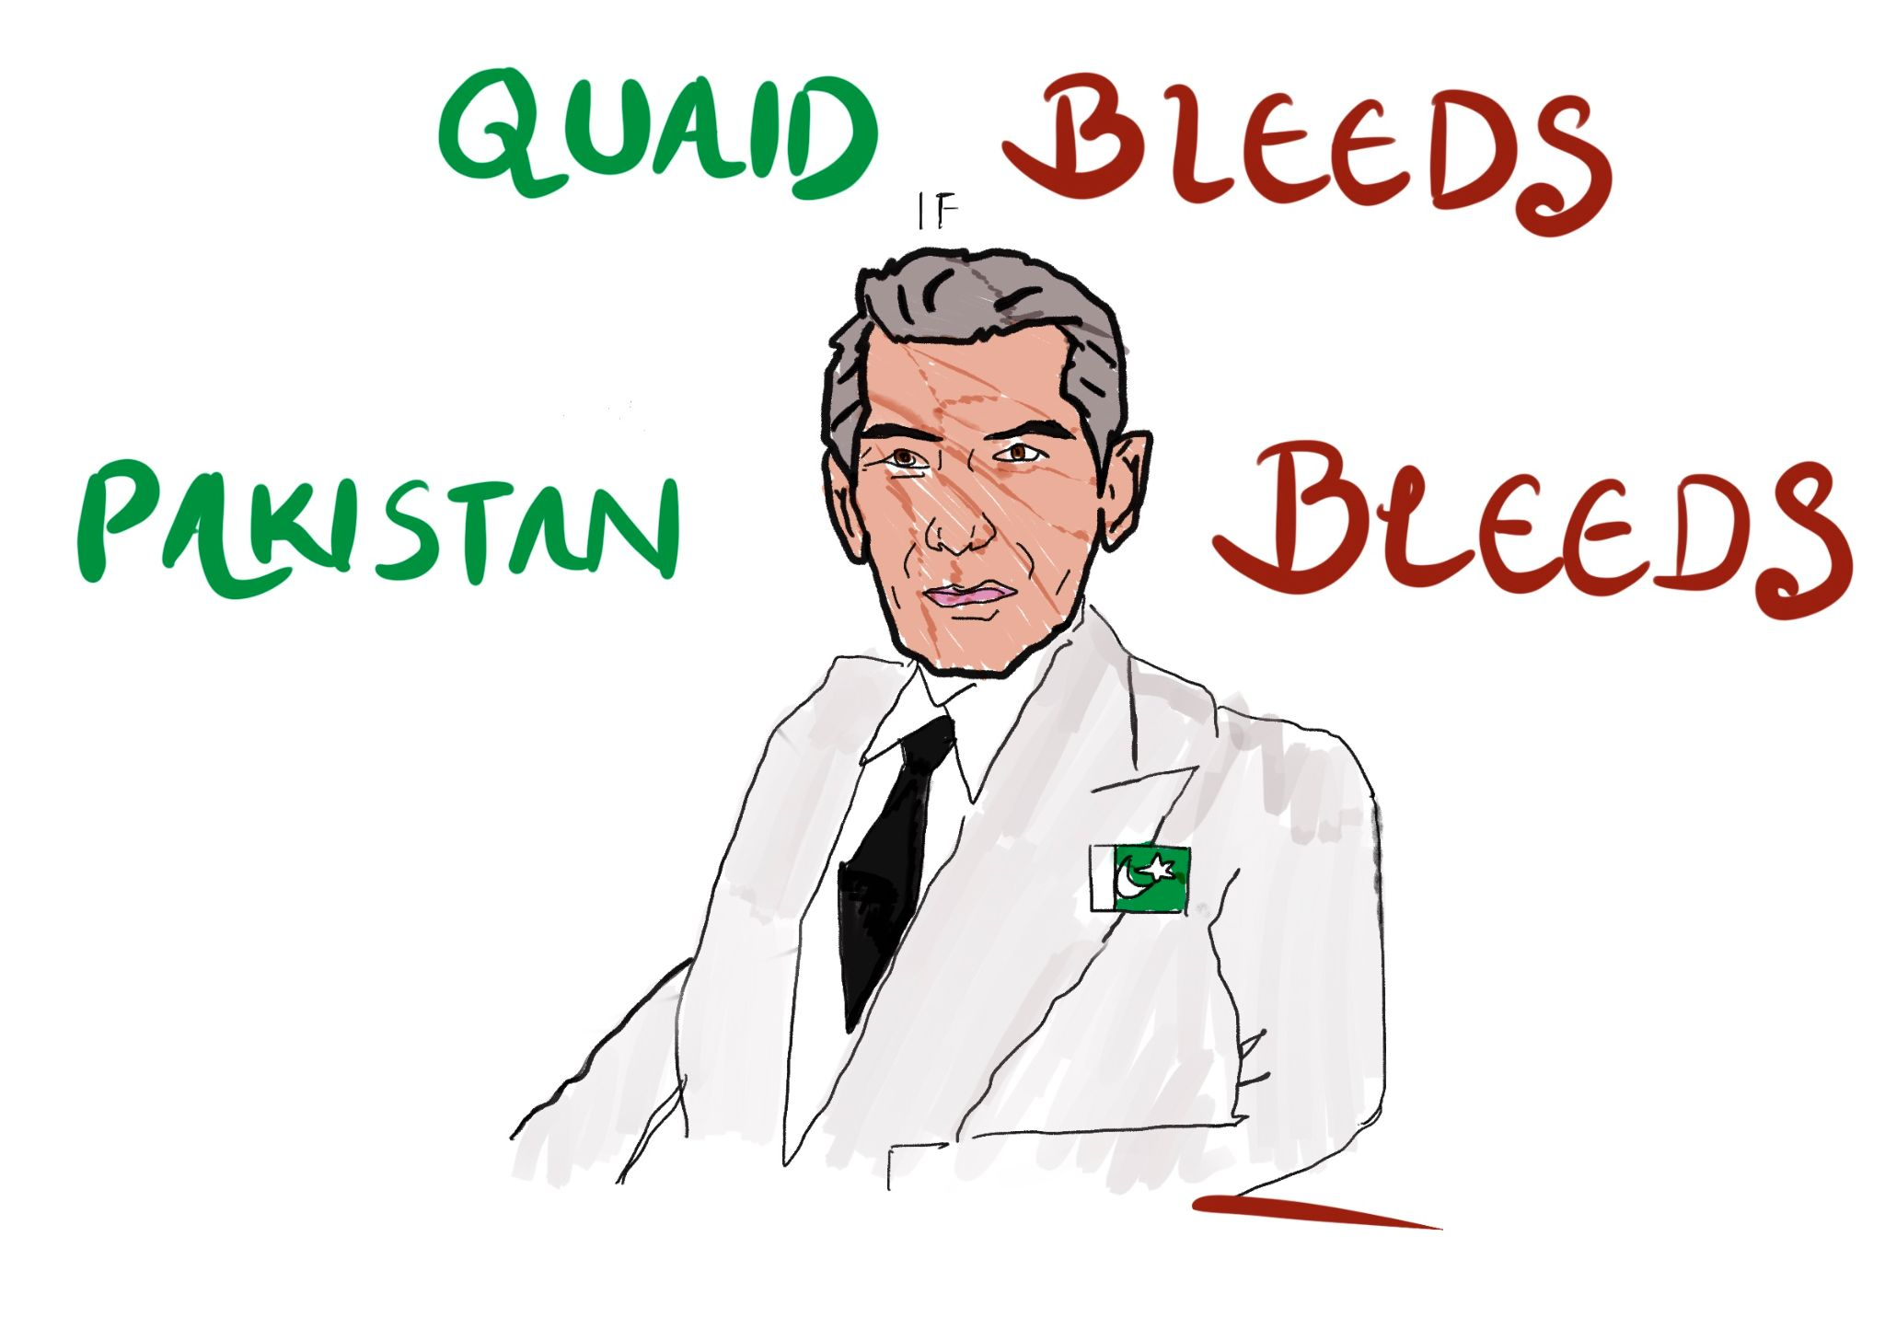

Slide 43
PARALLEL UNIVERSE
This satirical piece was done in the form of badges to signify the possibility of a parallel universe where all of the personalities of famous leaders was changed into something that is very uncharacteristic of them.

Slide 44
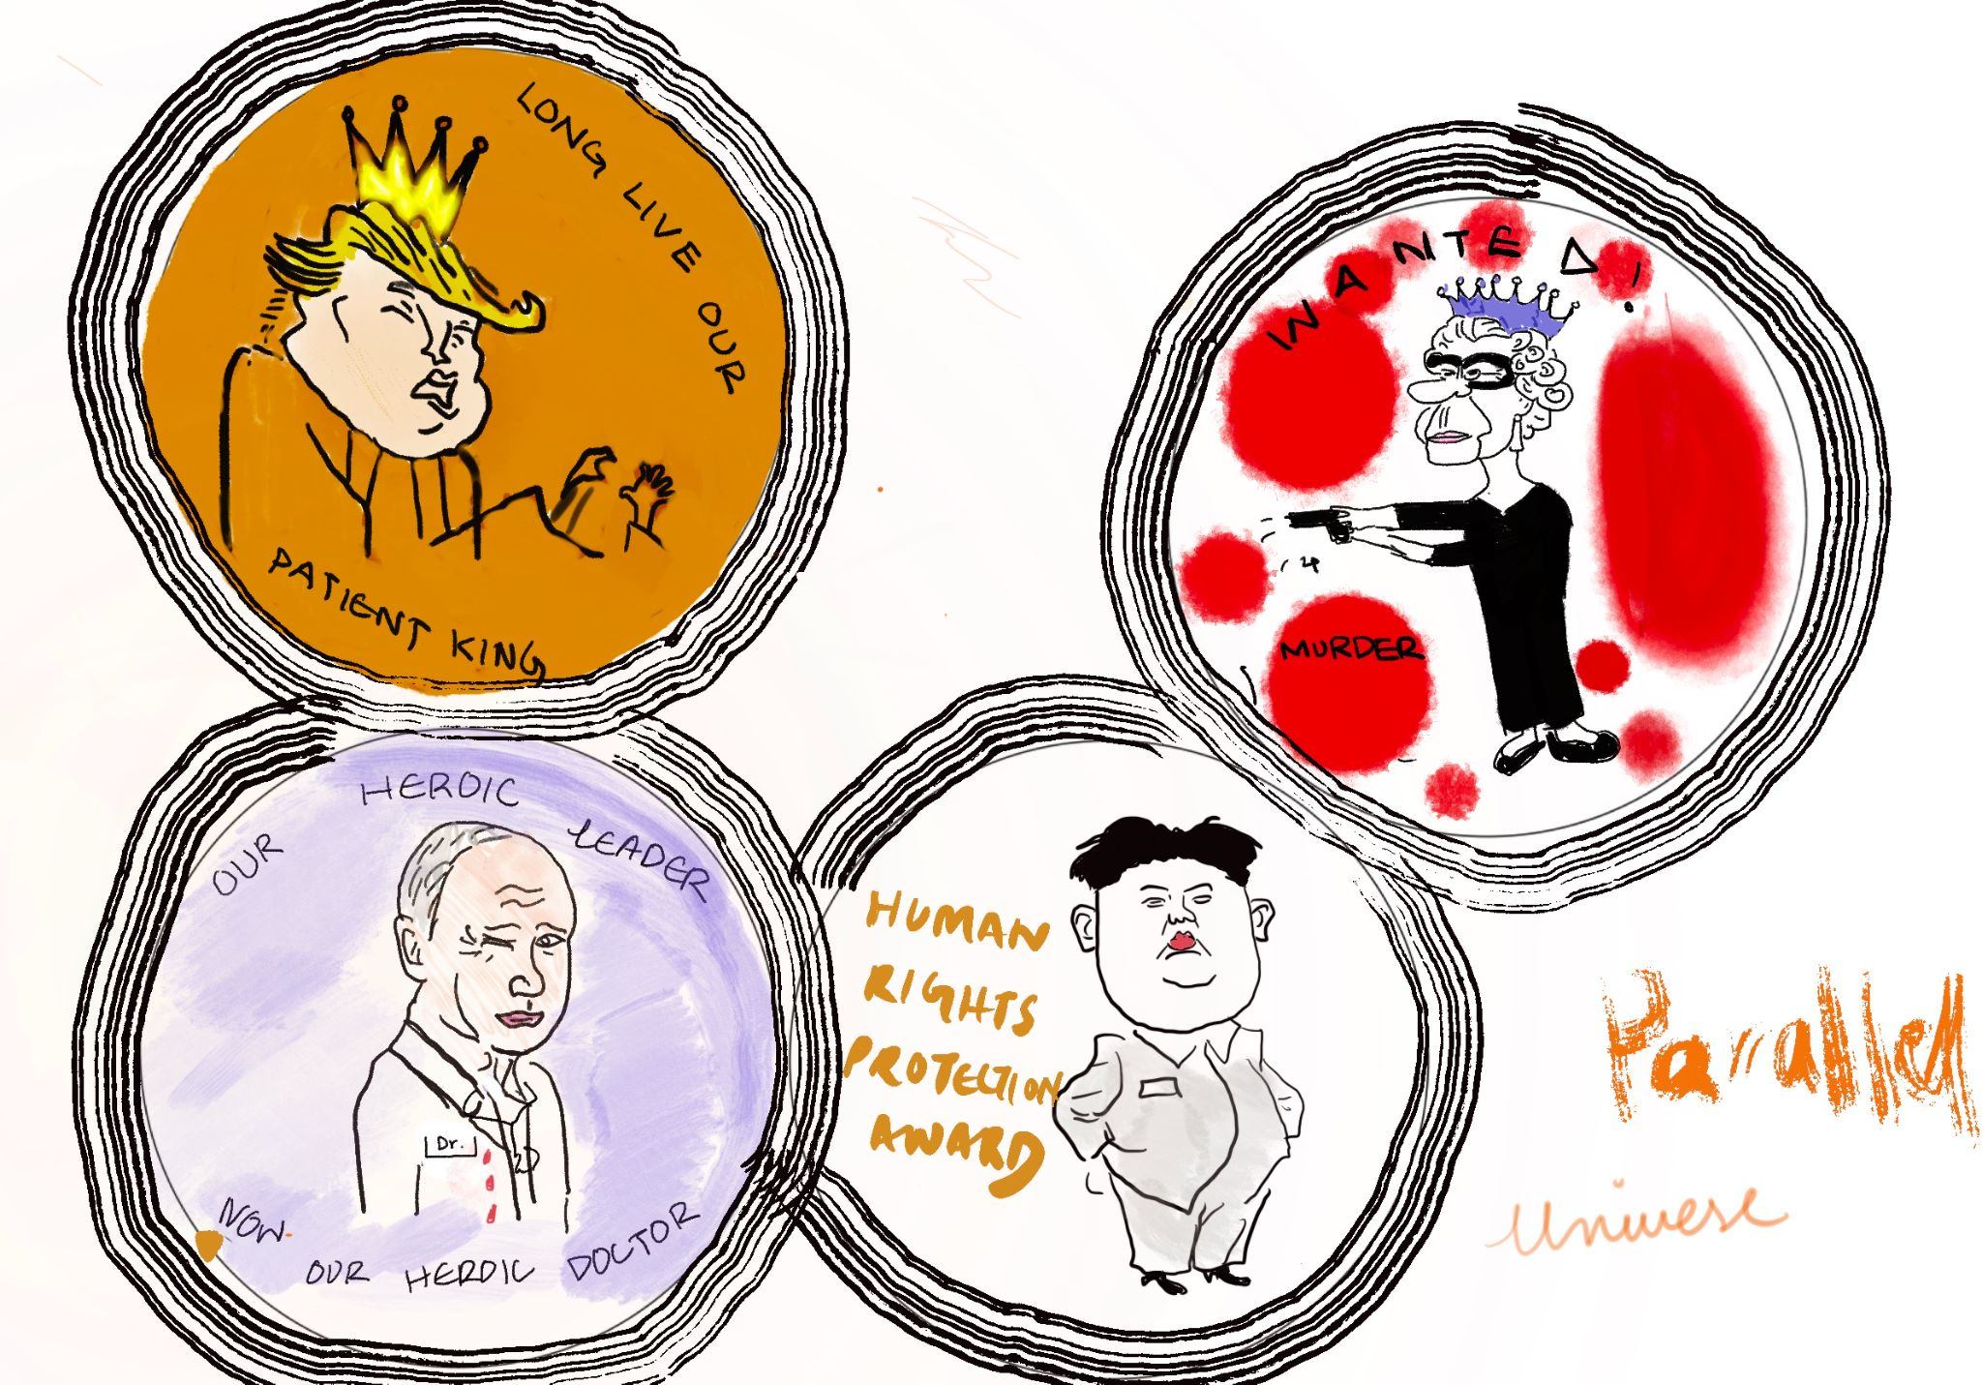

Slide 45
THE SPIRIT AND THE GUARD
The spirit and the guard in this piece was kept as intentionally being quirky and very astute by making the spirit’s and the guard’s facial expressions exaggerated and confused.

Slide 46
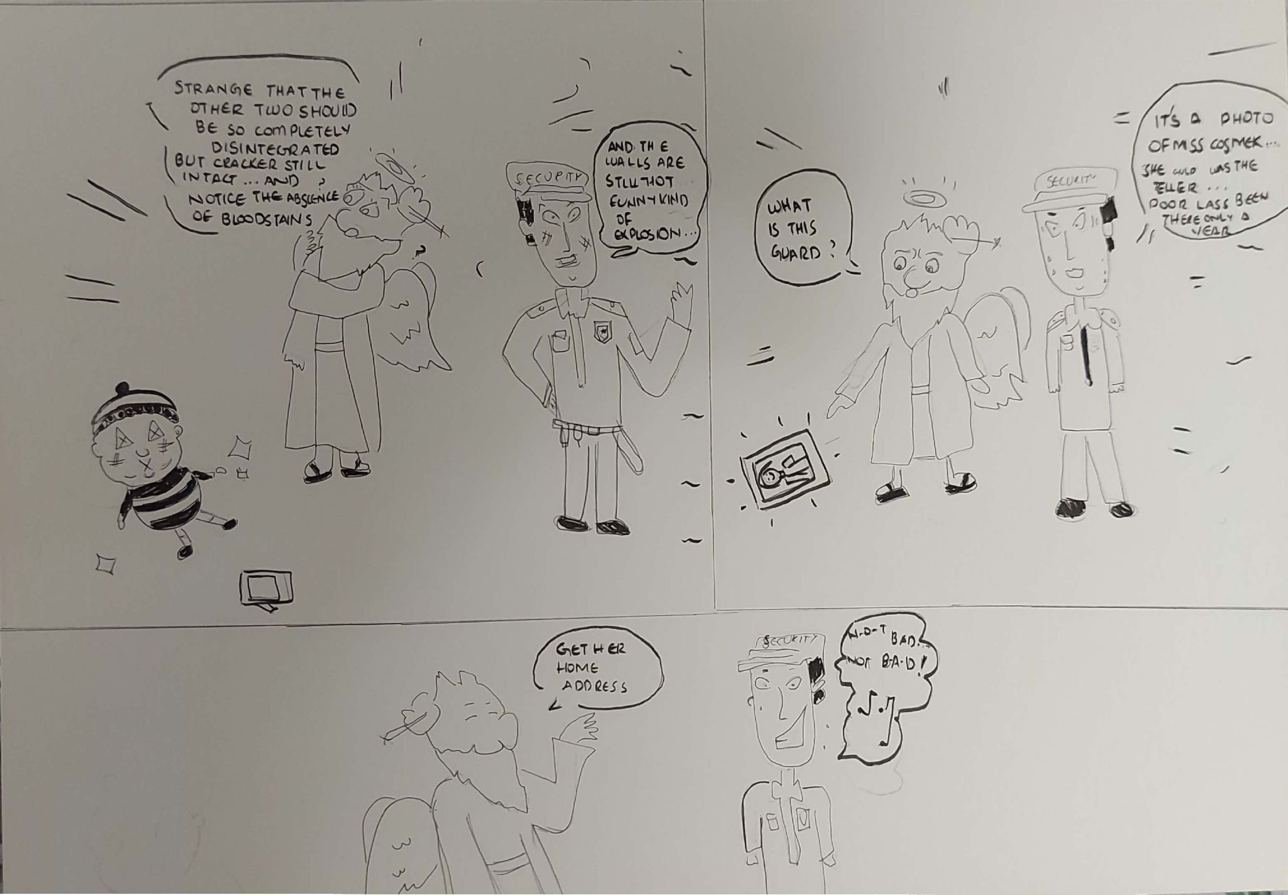

Slide 47
ANGEL AIRLINES SAFETY
THE angel from the previous spirit and guard makes a comeback as a manager for angel airlines. This piece was made to be intentionally ironic considering it was a safety manual to get a quick death and reach heaven through the angel airlines. In my opinion, these kind of safety manuals with humour would be read more by people rather than the procedural ones.
I had the idea of the safety manual being humorous because i have watched a lot of Qatar airlines safety videos while being on the airplane and they were actually really interesting and made you want to follow the procedures they listed.

Slide 48
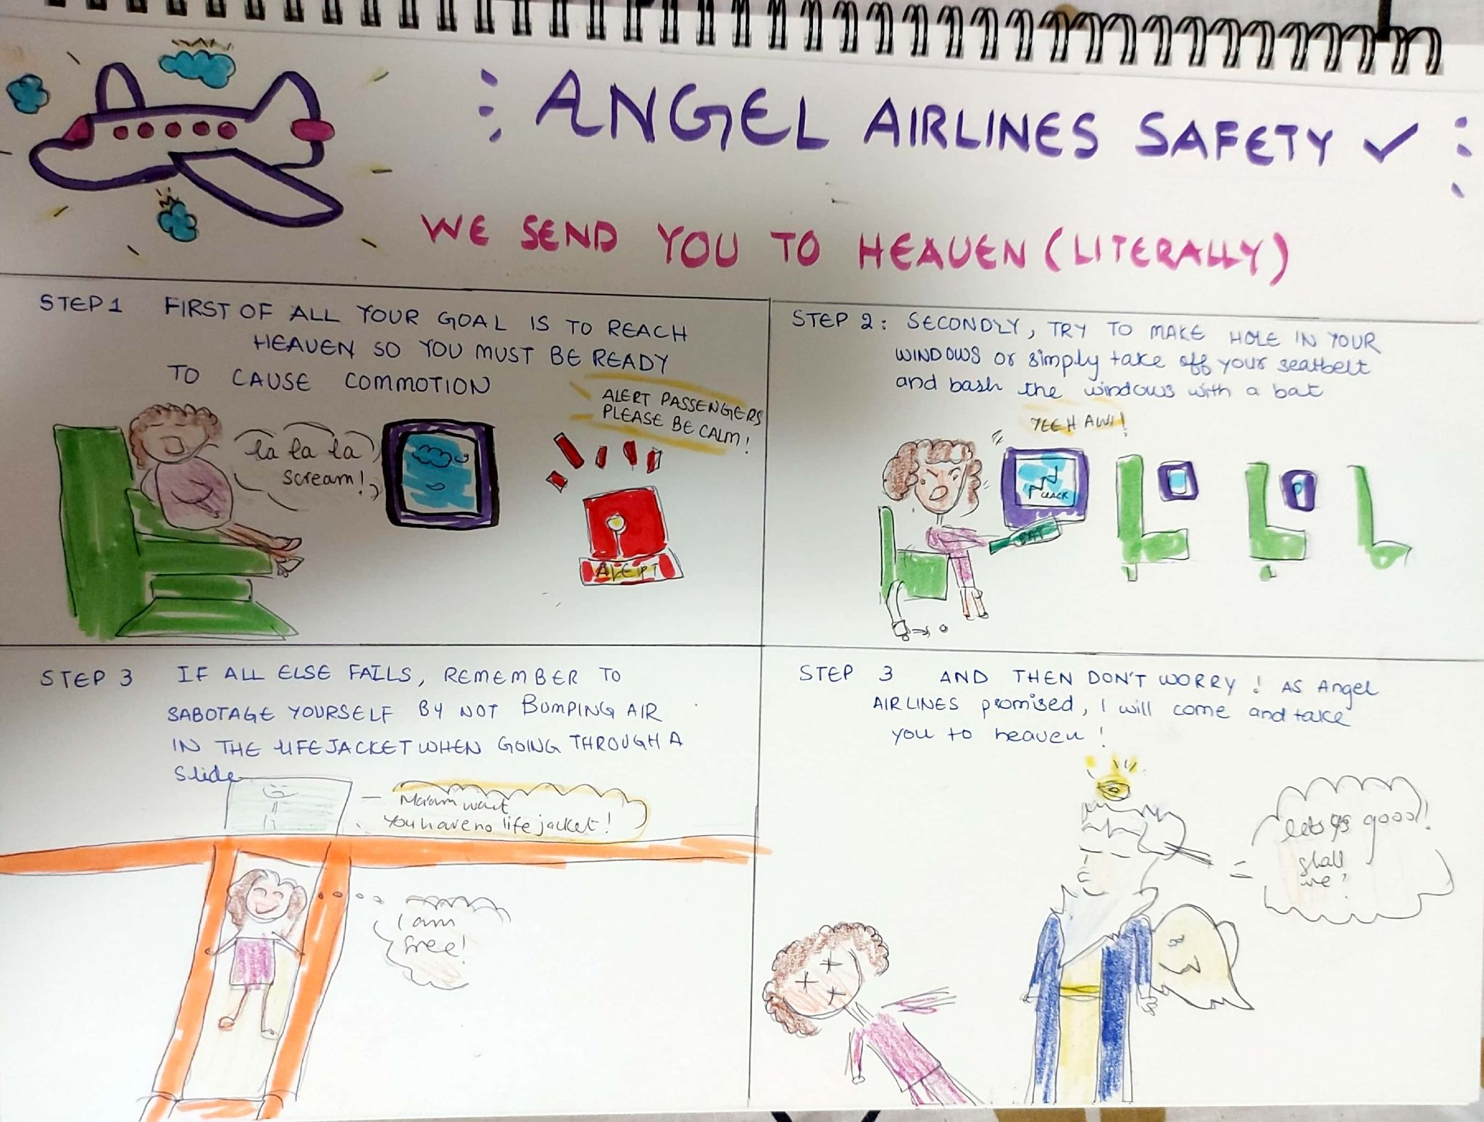

Slide 49
The Mysterious Skeleton
This piece was done to emulate a very rough and hurried character of people so as to emulate the tough conditions of cold and the scary event of finding a mysterious skeleton in the snow.

Slide 50
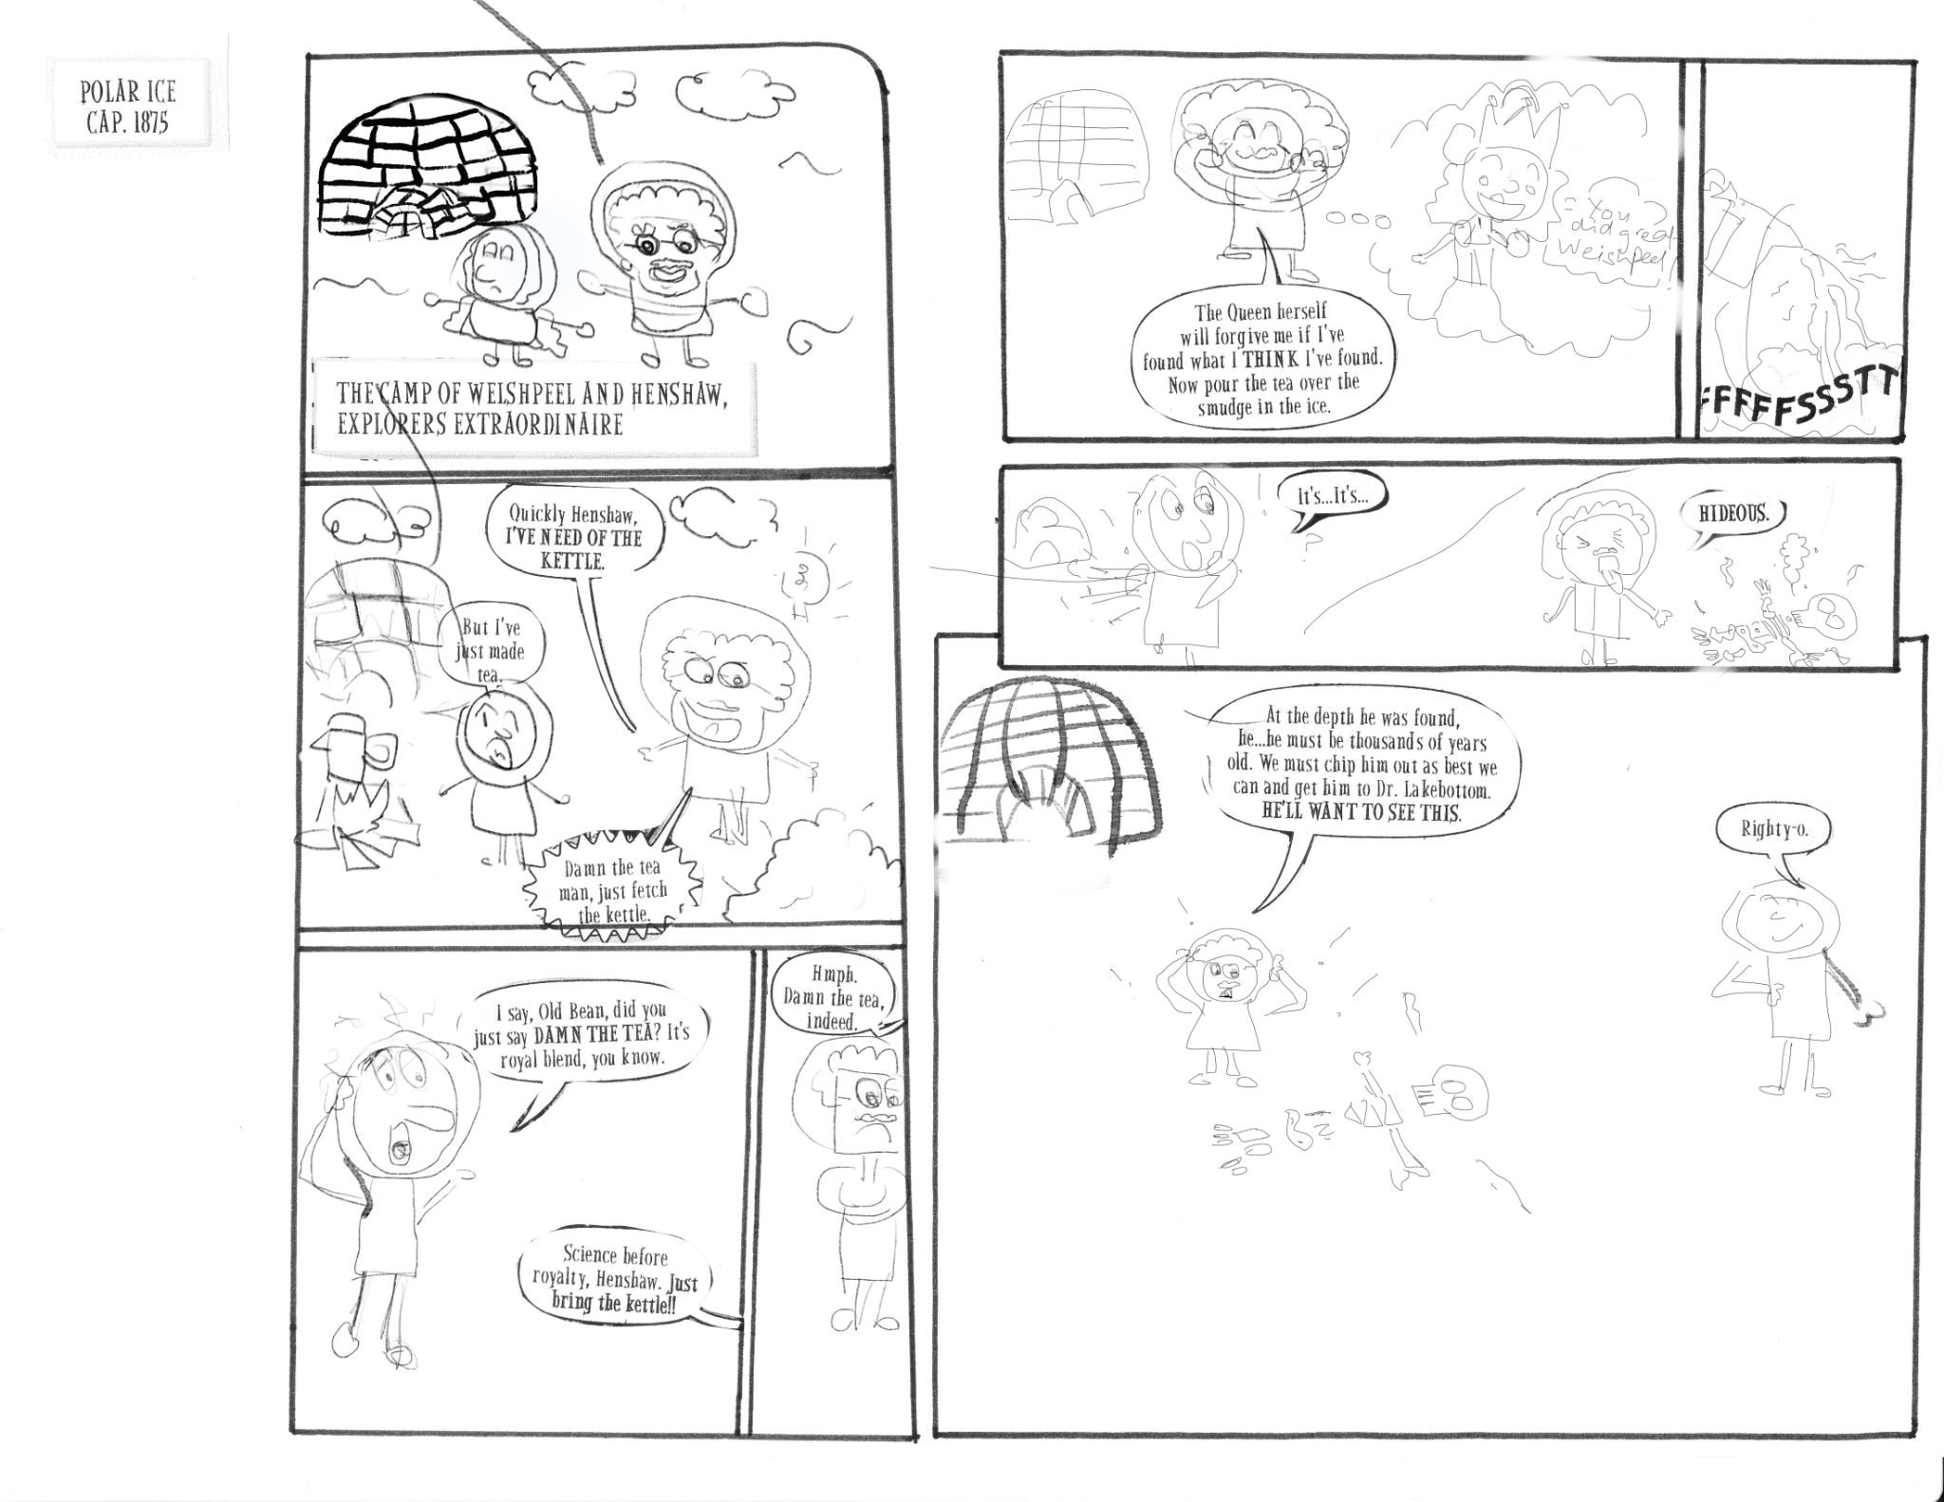

Slide 51
How to get your child to Eat
I had to spend a lot of time trying to decipher the emotions and relationship between the two characters before i finally decided on their relation being of a father and daughter. The abrupt change in emotions in my opinion could only be triggered if a parent does not let his teenager child have his way.

Slide 52
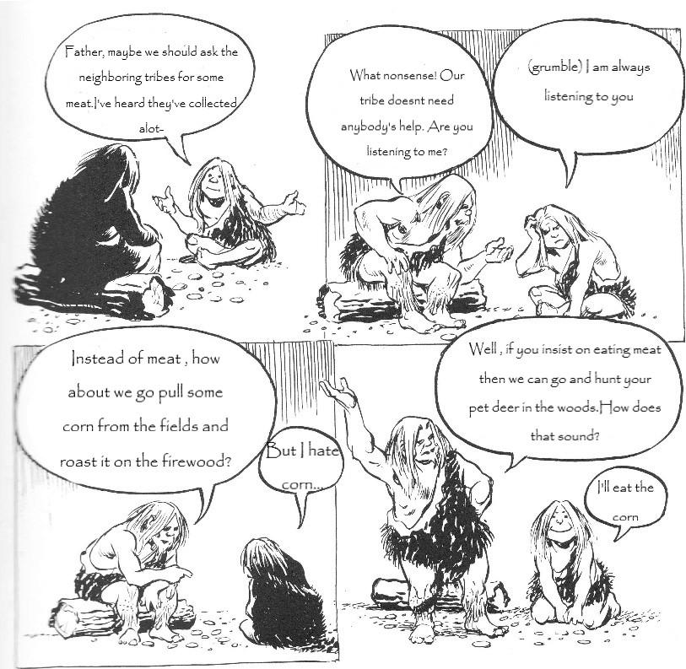

Slide 53
THe Unknown Man
This piece and the facial expressions of the characters had alot of mystery so my only choice was to make their relationship distant if not estranged. The unknown man in the end is the key to the mystery and i have made him be as such.

Slide 54
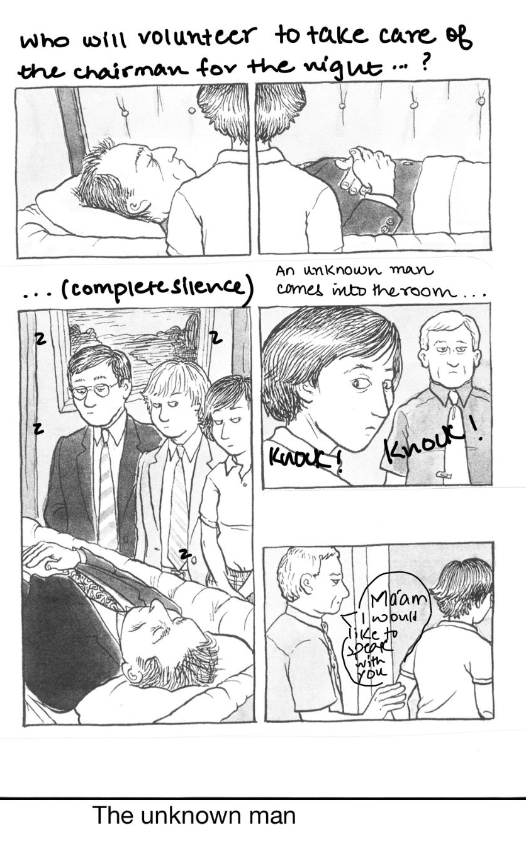

Slide 55
THE SOLAR WITCH
This piece was inspired by the works of Aubrey Beardsley who i have decided to expand upon with two more pieces. This one was drawn using felt tip markers with a white background and a lot of flowy dresses and formidable almost grotesque looking female who is the solar witch. THis is supposed to be an irony of her being the solar witch even though nothing is remotely solar about her. She is wearing only black and it seems like she has sucked out all the dark energy from the sun to make her self into a circular shadow of black

Slide 56
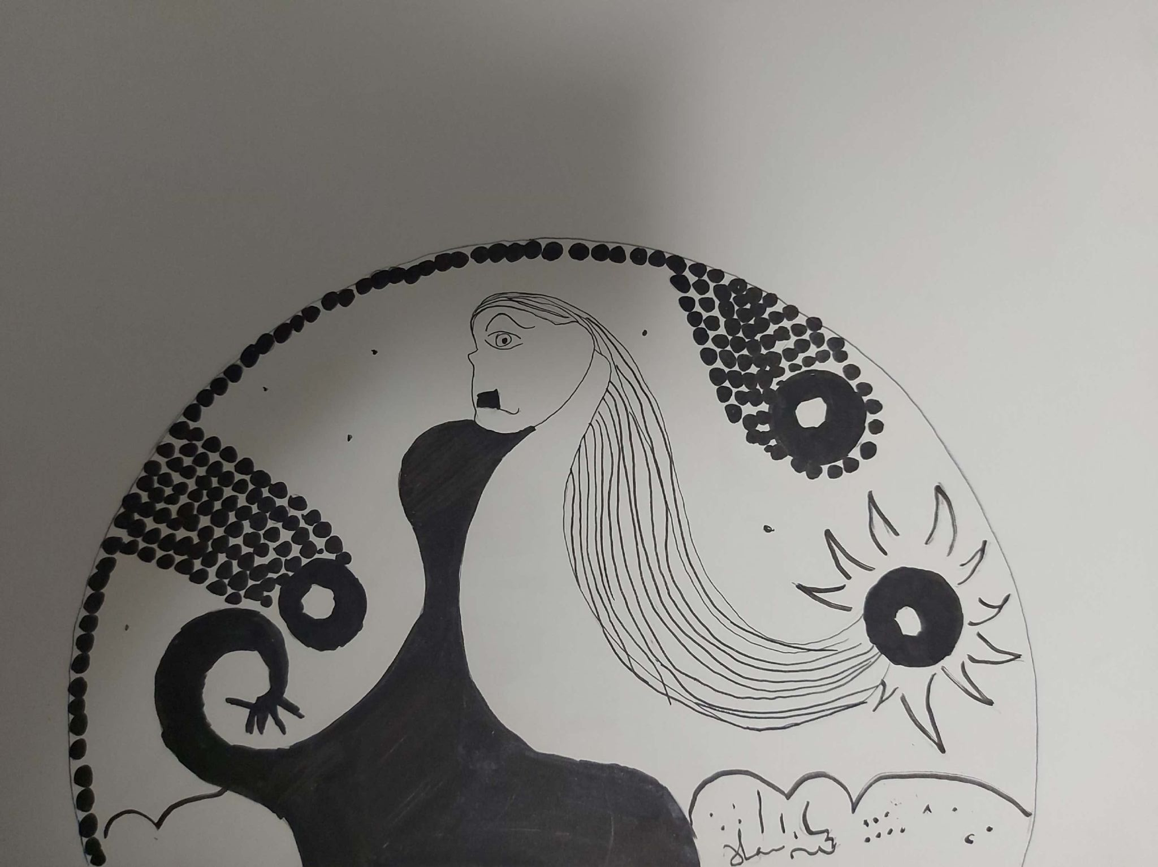

Slide 57
THE WHIRLPOOL OF WHITE
This is my extra piece which i have used to expand upon my insored world of Beardsley. I was always struck by how Beardsley used black, white and yellow. This time i used the background as pitch black and drew on it through a white studio pen with clear lines and recurring patterns of mini whirlpools.

Slide 58
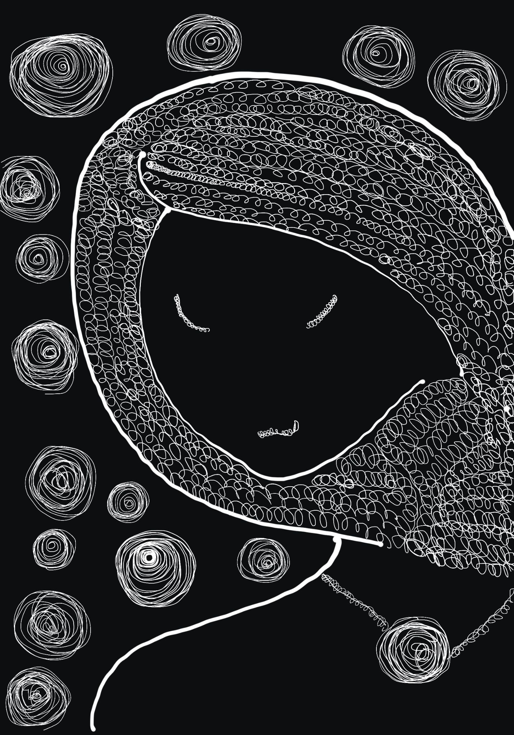

Slide 59
THE WINE CHALICE OF TEARS
This is my second expanded piece for Beardsley. This time, I used a faded yellow background this time to emulate a worn or decayed image of sorrow and blood disguised as a chalice of wine and tears.

Slide 60
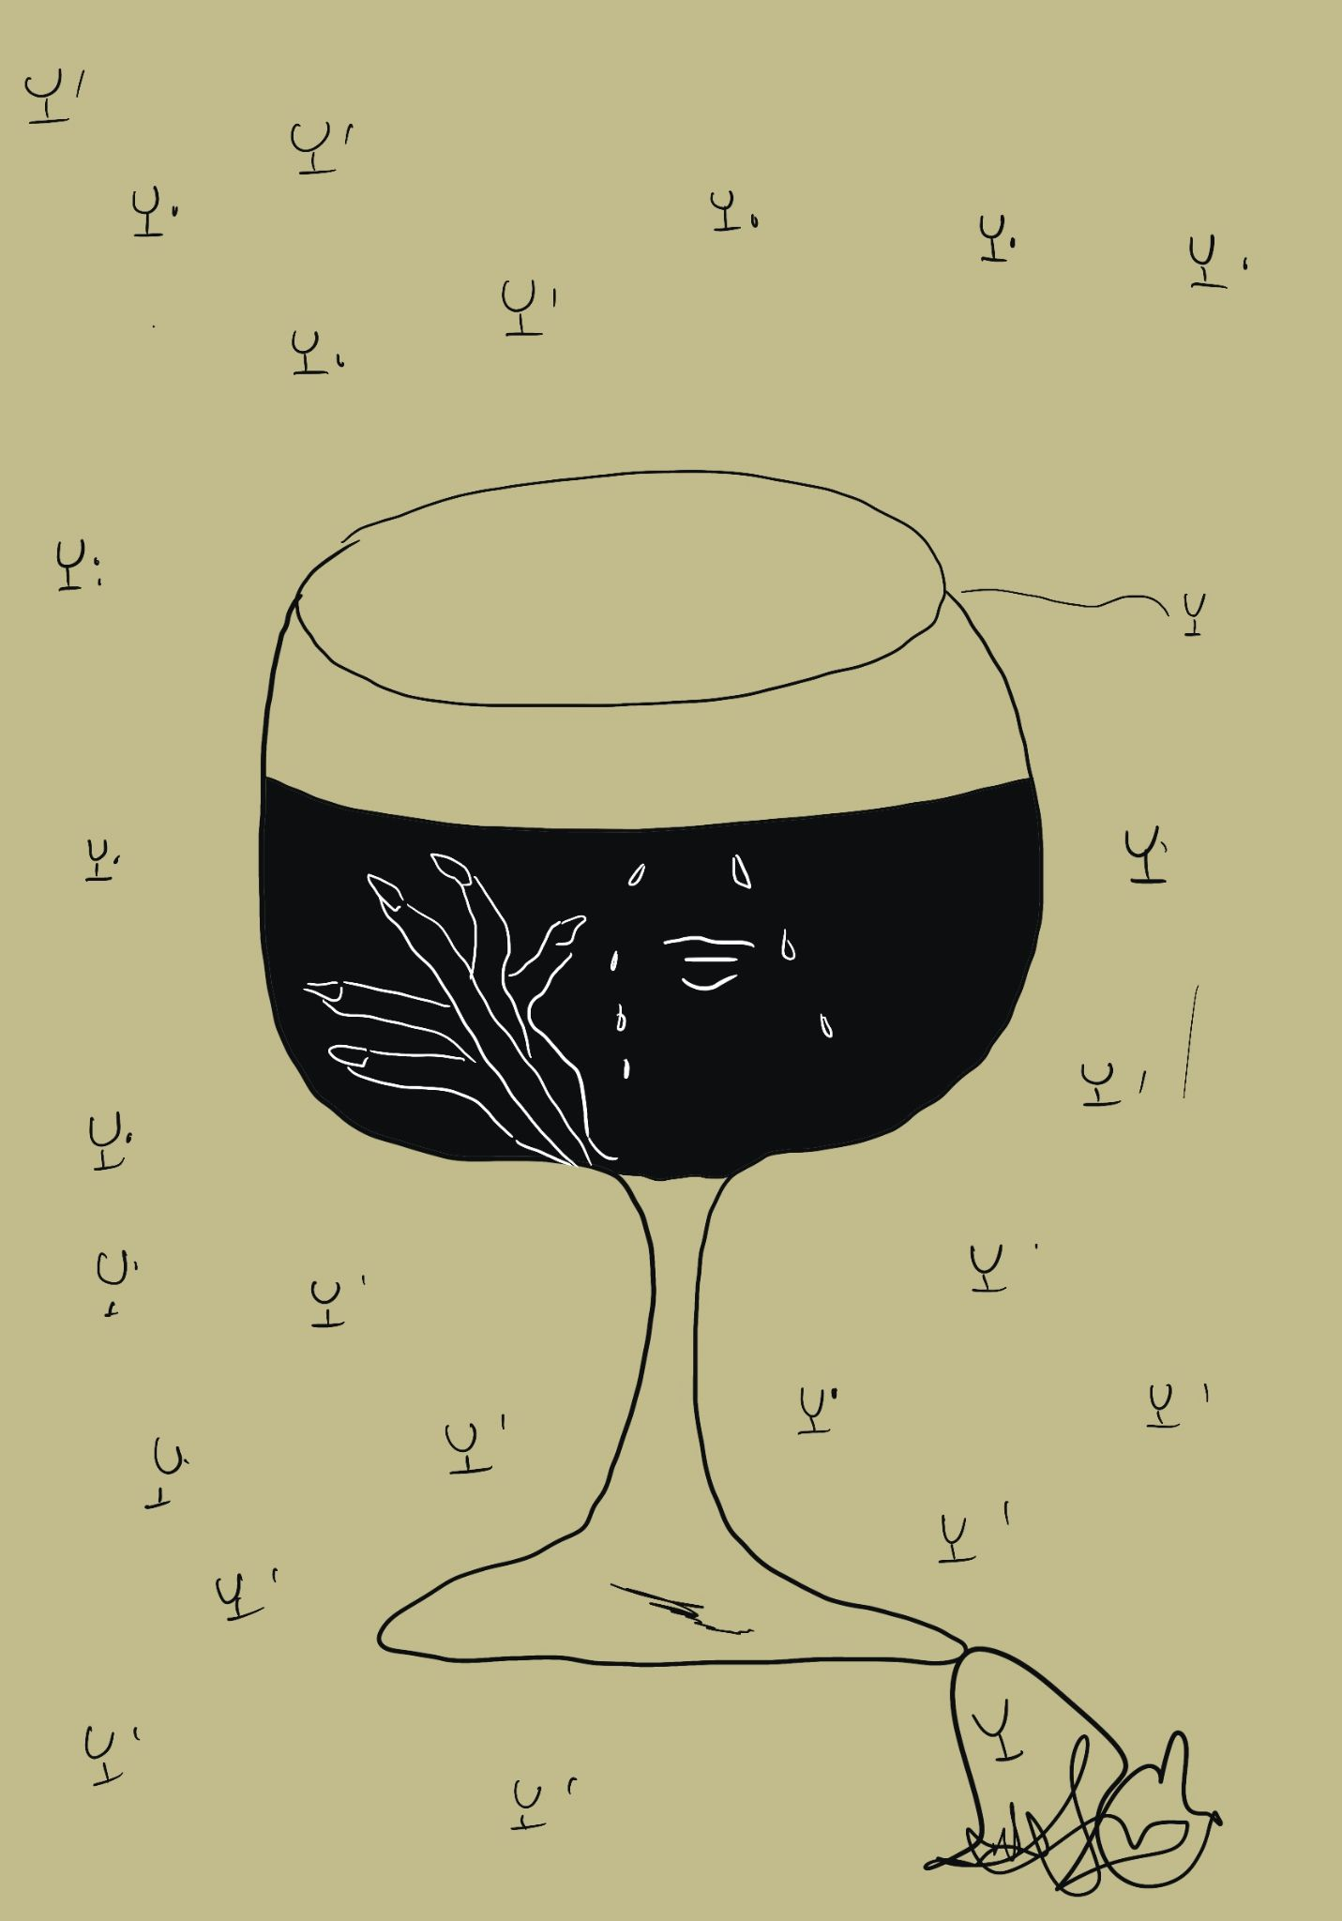

Slide 61
Thankyou

